Slide 1
Accessible Slides in Practice
An example deck you can copy from
VCU School of Medicine ADA Title II
September 2026
Notes:
This deck is both the lesson and the template. Every slide is built from a built-in VCU layout, uses Arial at 16pt or larger, and is designed to clear the PowerPoint Accessibility Checker. Copy a slide, replace the text, and the structure comes with it. Slides 2 through 6 cover structure; slides 7 through 11 cover images and media; slides 12 and 13 are the repair example and the checklist.

Slide 2
How to Use This Deck
Build slides from it
Check before you post
Add slides with Home → New Slide → Layout. Never start from an empty box.
Type the title into the title placeholder, then confirm it in View → Outline.
Copy the example closest to your content and replace the text.
Keep Arial at 18pt or larger, and keep text black on white.
Run Review → Check Accessibility and clear every error.
Right-click each image → View Alt Text and name its teaching point.
Open Home → Arrange → Selection Pane and read the list bottom to top.
Read the notes pane — it names the habit each slide demonstrates.
Start here: the layout does the structural work. A title typed into a placeholder becomes a real heading for a screen reader; the same words in a drawn text box do not.
Notes:
Habit demonstrated: real heading styles. Structure comes from the layout, not from font size. Outline view is the fastest proof — if a title is missing there, the slide has no title for assistive technology and the checker will flag it.

Slide 3
Color, Contrast, and Type Size
Pairings that pass
Do not rely on color alone
Black background, white text
Label data on the chart itself instead of a color-only legend.
Pair red or green with a word: “Overdue,” “Complete.”
Keep links underlined so they still read as links in grayscale.
VCU gold background, black text
White background, dark gray text
Gold is a background color, not a text color. Behind black text it reaches compliance, as gold text on white does not. Ensure body text is 18pt and titles at 28pt or larger.
Notes:
Habit demonstrated: color is never the only cue, and contrast is at least 4.5:1 for body text and 3:1 for large text and icons. WebAIM's contrast checker gives you the ratio in seconds. Print a slide in grayscale: if the meaning survives, you have not leaned on color.

Slide 4
Charts: Insert Them, Never Screenshot Them
A native chart is accessible data
Insert → Chart keeps the numbers behind the picture. A pasted screenshot has no data and no selectable text.
Every column is labeled
The value sits on the bar, so the chart still reads in grayscale and needs no color-coded legend.
It still needs alt text
“Column chart, sample data: courses meeting WCAG 2.1 AA. Year 1, 82 percent; Year 2, 74; clerkships, 61; electives, 45.”
Notes:
Habit demonstrated: alt text on every image, plus color is not the only cue. For a chart, good alt text gives the shape of the data and the values that matter — not a description of the bars. If the table behind the chart is the real content, put the table on the slide instead.

Slide 5
Tables: One Header Row, No Merged Cells
File type | What to check | Where to check it | Time
Slides | Unique title, alt text, reading order | Review → Check Accessibility | 10 min
PDFs | Tags, reading order, selectable text | Acrobat → Accessibility check | 15 min
Video | Captions, transcript, described visuals | Caption editor in your video tool | 20 min
Handouts | Heading styles, link text, tables | Word → Check Accessibility | 10 min
Why this table passes
The top row is marked in Table Design → Header Row, every cell holds text, nothing is merged or split, and the type is Arial 18pt in black — a 21:1 contrast ratio.
Notes:
Habit demonstrated: tables have header rows. Insert → Table creates a real table; a grid of text boxes does not. Set Table Design → Header Row, never merge cells, and never leave one blank — a screen reader loses its place. Use a table for data, never for page layout.

Slide 6
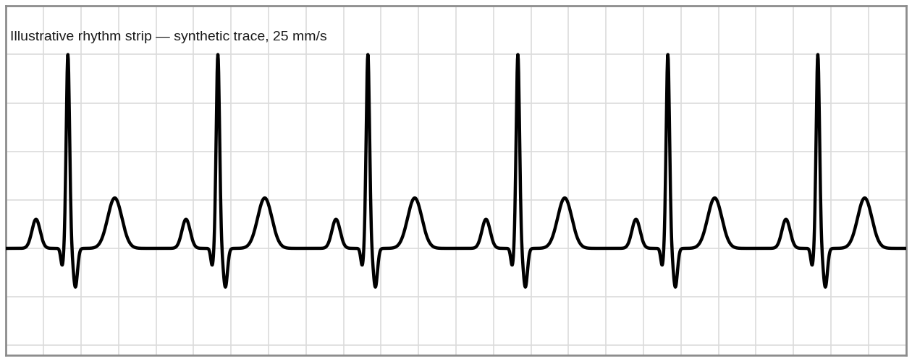
Images: What Good Alt Text Sounds Like
Too vague
“ECG strip.” Names the object, not the point. A student who cannot see it learns nothing.
Too long
“Rhythm strip on standard graph paper at 25 mm per second, six beats, each with a rounded upright P wave, a narrow QRS…” Screen readers read every word, with no way to skim.
Just right
“Illustrative rhythm strip: regular narrow-complex rhythm at about 75 beats per minute, with a P wave before every QRS.”
The shape of a good description
One sentence, 15 to 20 words: name what the image is, then the point it makes. Two sentences means it is a complex figure — see the next slide but one.
Notes:
The alt text on the image to the left is the third version. Write for the student's ear: what is this, and what should I take from it? Skip “image of” and “graphic of” — the screen reader already announces that it is an image. If the image is the question on an exam, use the testing pattern on the slide after next instead.

Slide 7

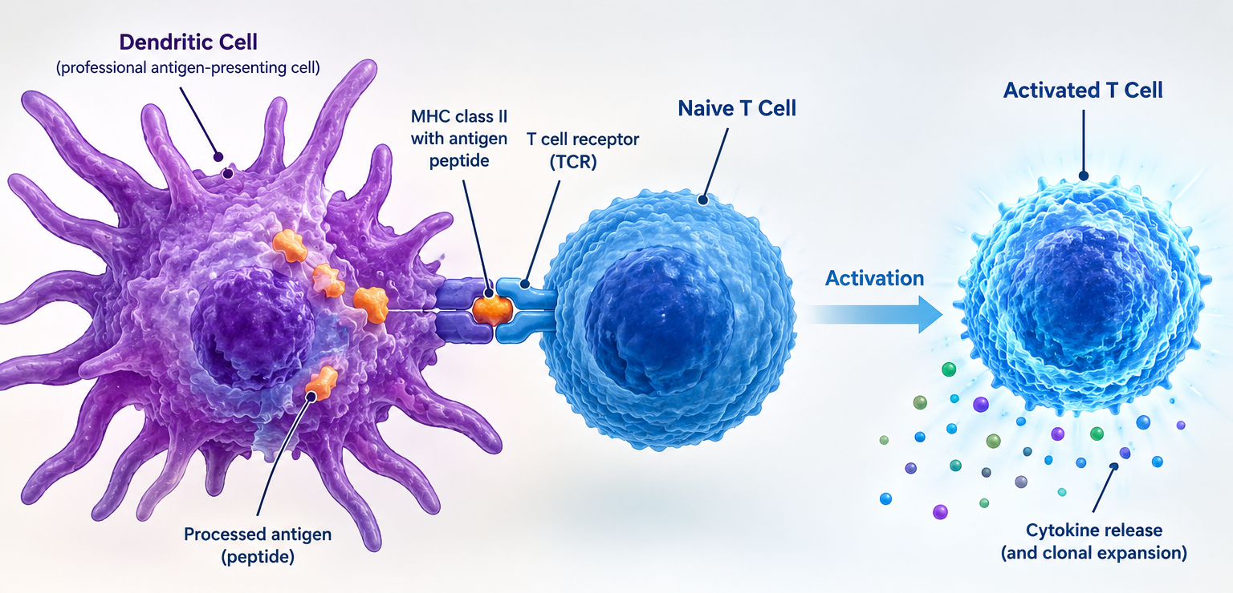
Decorative or Informative?
Decorative — mark it, do not describe it
Ornament carries no information. Right-click → View Alt Text → check “Mark as decorative.” Screen readers skip it and the checker stops asking.
Informative — write the teaching point
Alt: “Diagram: a dendritic cell presents antigen to a naive T cell, activating it.” Remove the image and the slide loses content — so it needs words.
Notes:
The test: if you deleted the image, would the slide lose information? If yes, describe it. If no, mark it decorative — that is a real fix, not a shortcut, and it clears the checker. The left image on this slide is marked decorative; the right one carries alt text. Logos, background textures and divider art are almost always decorative.

Slide 8
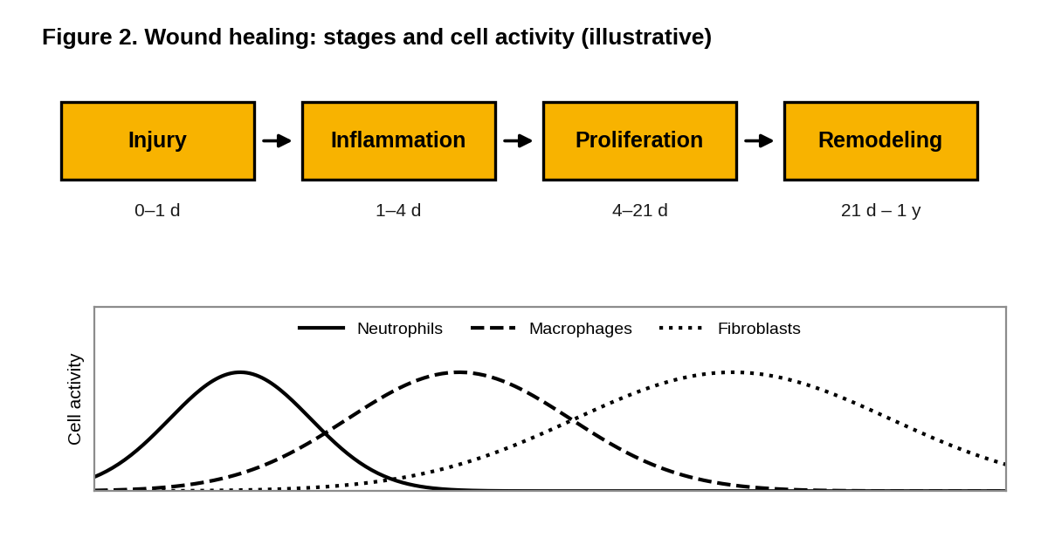
Complex Figures: Short Alt, Full Description
Short alt text, on the image
“Figure 2: four stages of wound healing with a graph of cell activity over time. Full description in the text beside the figure.”
Full description, on the slide or in the notes
“Stages run injury, 0 to 1 day; inflammation, 1 to 4 days; proliferation, 4 to 21 days; remodeling, 21 days to 1 year. Neutrophil activity peaks first, macrophages next, fibroblasts last and longest.”
The full description is the figure legend you would have written anyway — and sighted students read it too.
Notes:
Multi-panel figures, pathways and flowcharts cannot fit one sentence. Pair short alt text with a full description the student can reach: visible text on the slide, the notes pane, or a linked handout — and say in the alt text where that description lives. Note the figure also uses line style, not color alone, to separate the three curves.

Slide 9
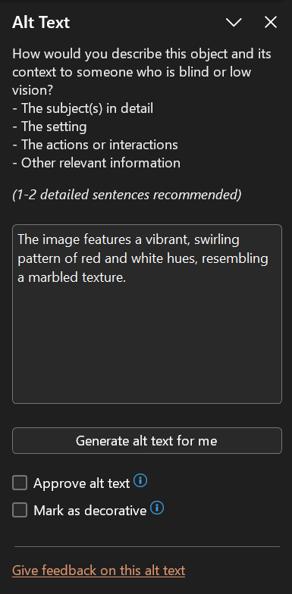
When the Image Is the Question
Teaching: describe it in full
There is no answer to protect, and the description is good teaching for everyone.
Alt: “Micrograph of normal cardiac muscle: branching fibers, central nuclei, intercalated discs.”
Testing: identify, do not reveal
Rules exempt an image that is a test text would give away. Name the image type only, and keep the question, choices and buttons accessible.
Alt: “Photomicrograph of a tissue section - Q14.”
Accommodations are a separate track
Send the student to SAEO before the session, not the morning of. A trained describer, a tactile version, or an equivalent question all work. If seeing the image is a true program requirement, that call belongs to your office and counsel.
Notes:
This is the question faculty ask most: does alt text give away the answer? Only if you let it. Describing what a sighted student can see is fair; naming the diagnosis is not. The exception is in the standard itself, so you are not cutting a corner by using it.

Slide 10
Links, Captions, and Transcripts
Link text
Video and audio
Name the destination of the link: “Digital Histology Website.”
Never “click here,” “read more,” or a bare web address.
Keep them underlined, so they read as links without color.
Auto-captions are a draft — fix the terminology and the drug names.
Audio-only content needs a transcript.
No autoplay for embedded videos; keep controls reachable by keyboard.
A clip you embed is a clip you own — if it is not captioned, it is not ready to post, even when someone else made it. (ie. Youtube videos, etc.)
Notes:
Habit demonstrated: descriptive links. Screen reader users often pull up a list of every link on a page or slide — four items reading “click here” are useless in that list. For media, captions serve far more students than the ones with documented accommodations, including anyone watching in a noisy room.

Slide 11
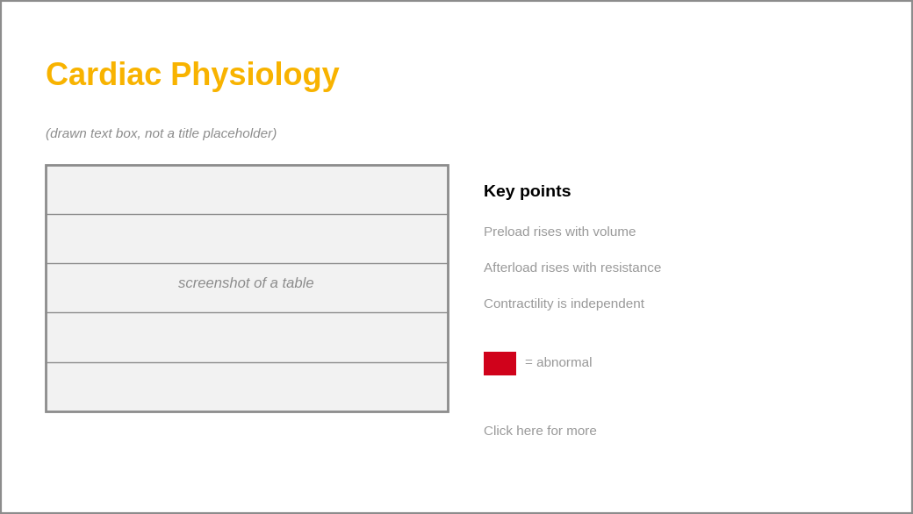
Before and After: One Slide, Five Fixes
1. Title drawn as a text box
No title in Outline view, so the slide has none.
2. Gold text on white — 1.8:1
Use black text; keep gold behind it.
3. A screenshot of a table
No selectable text, no header row.
4. Small, faint body text
12pt light gray. Use 18pt black.
5. “Click here” and a color-only key
Name the destination; label the red square.
Every fix here takes under two minutes.
Notes:
Run the Accessibility Checker on the slide at left and it reports the missing title, the missing alt text and the contrast problem in seconds; the screenshot and the link text are the two it cannot catch for you. This is the slide to show a skeptical colleague.

Slide 12
Final Review
1. Build from a layout, never a blank box.
2. Give every slide one unique title, and check View → Outline.
3. Add alt text to every image; mark the ornament decorative.
4. Black on white, Arial, 18pt body and 28pt-plus titles.
5. Real tables with a header row — no screenshots.
6. Name your links by their destination.
7. Run Review → Check Accessibility and clear every error.
Where to learn more
VCU Digital Accessibility
Local how-tos, FAQs and standards
WebAIM resources
Alt text, contrast, tables, links
Microsoft accessibility support
The checker in PowerPoint, Word and PDF
One file. One fix. This week.
Notes:
Ten minutes per file, on the file you are about to post. The link text on this slide is itself the example — each one names its destination and is underlined, so it survives grayscale printing and reads correctly in a screen reader's list of links.

