Slide 1
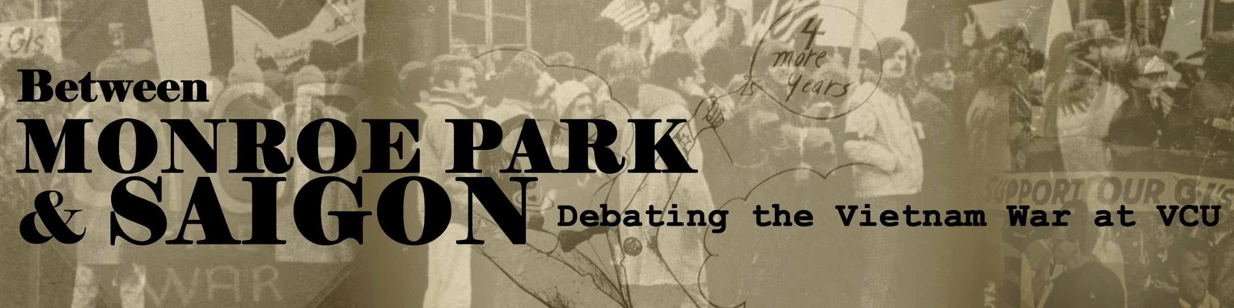
Exhibition curated by the Class of
History 657: Controversy & Public History
Meredith Glasco, Elliott Martin, Kayla Payne, James Randall
& Dr. Emilie Raymond

Slide 2
Introduction
The United States supported South Vietnam from November 1955 until April 30, 1975 when North Vietnamese forces overran the capital city of Saigon. During the height of the Cold War, the U.S. helped establish a non-communist government in South Vietnam to “contain” the communist influence of North Vietnam, China & the Soviet Union in Southeast Asia. After the Viet Cong–guerilla fighters aligned with the North Vietnam Army–successfully destabilized the Saigon government in 1963, the U.S. sent its own military forces. Over 550,000 Americans would serve in Vietnam and almost 59,000 would perish. Deeply impacted by the war and its growing controversy, the Virginia Commonwealth University community remained committed to the free exchange of ideas during the tumultuous debates of the era.

Slide 3
1965-68: The Build-Up
Between 1965 and early 1968, the forerunners to VCU–Richmond Professional Institute (RPI) and the Medical College of Virginia (MCV)–indicated support or neutrality to American involvement in Vietnam. Students expressed approval for the war effort in surveys, raised money for troops and donated blood, and invited war hawks to speak on campus. MCV alumni treated civilian and military patients in South Vietnam, winning accolades in campus publications, while a growing number of veterans enrolled in classes. Those opposed to U.S. efforts in Vietnam found expression in underground publications and began organizing small actions in Richmond, like the Sgt. Pepper’s Peace Parade, or excursions to Washington D.C. to participate in national events like the Washington Peace March, both in 1967. However, even one sign protesting the war made front-page campus news in early 1968.

Slide 4
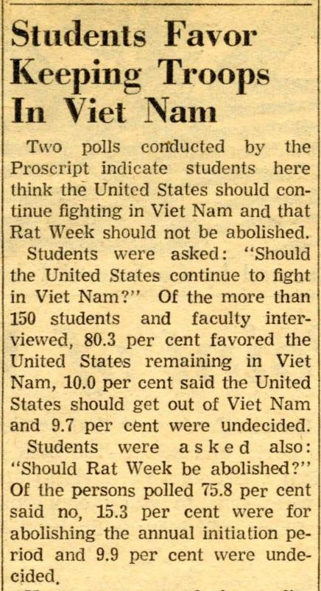
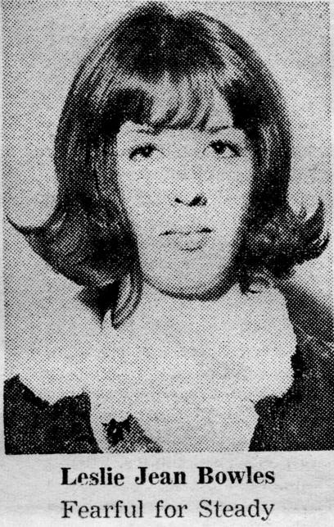
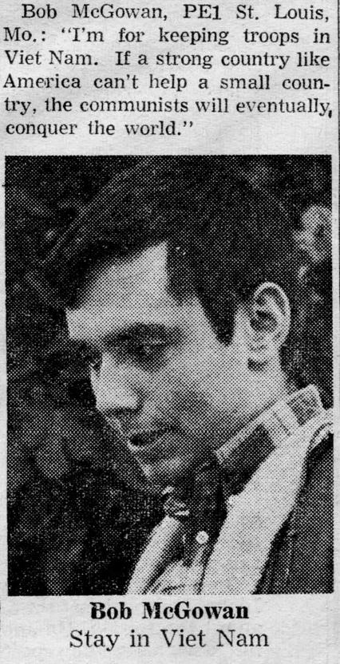
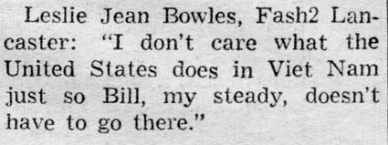
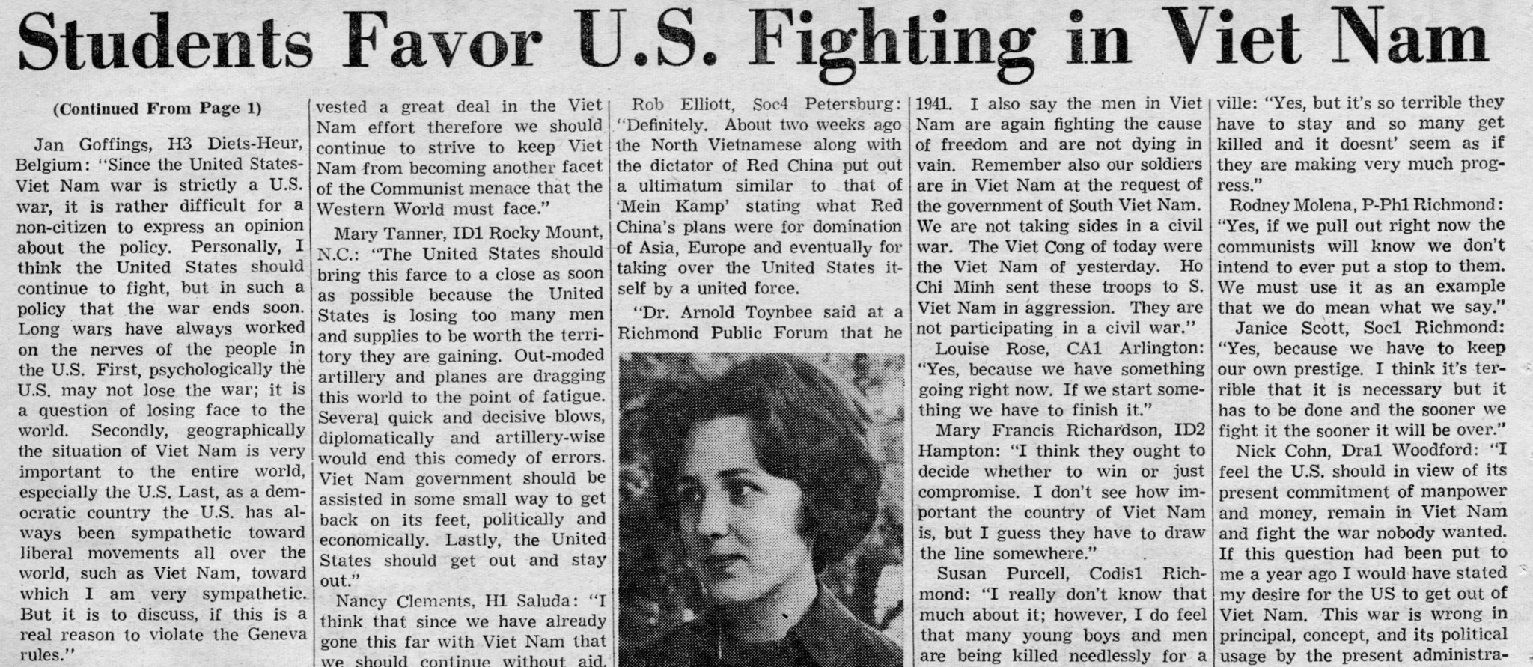

Slide 5
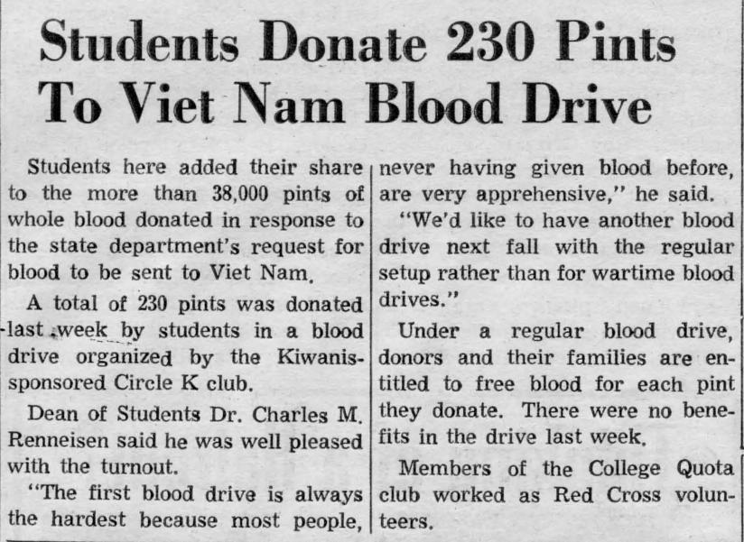

Slide 6
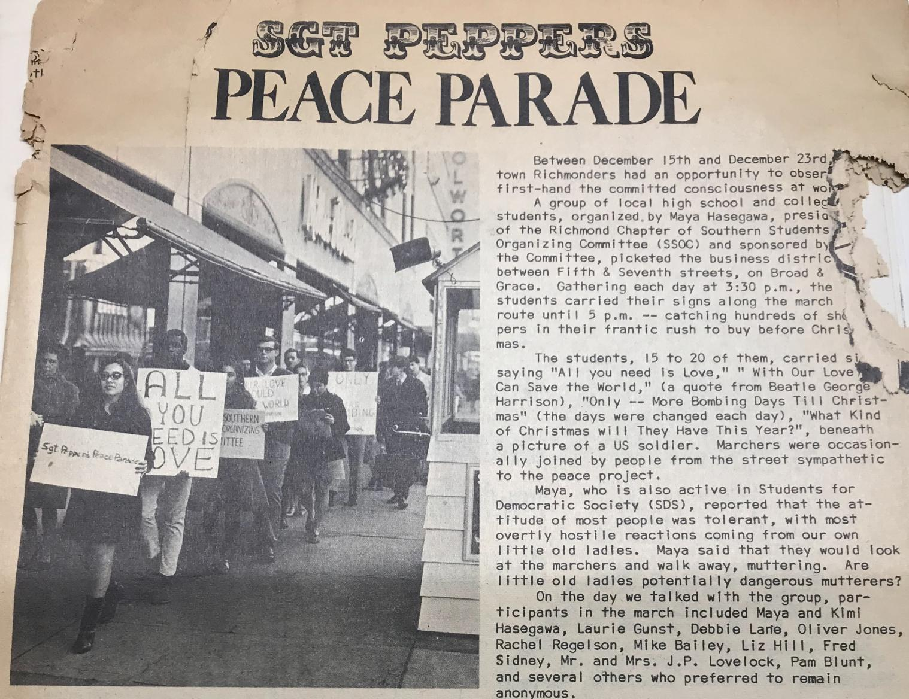

Slide 7
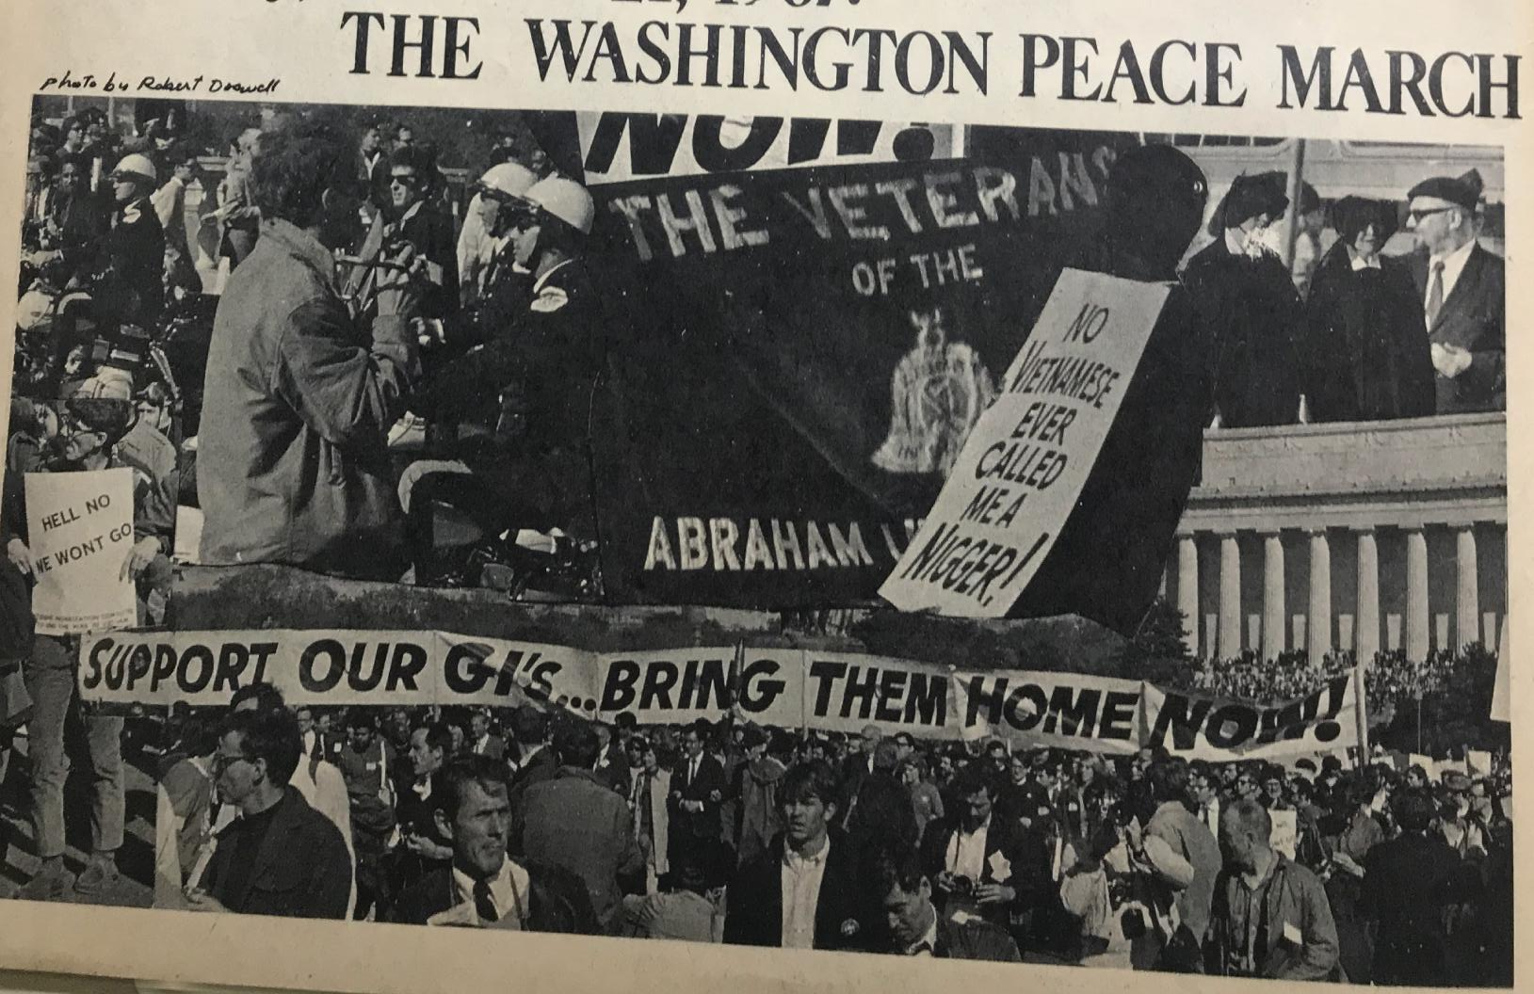
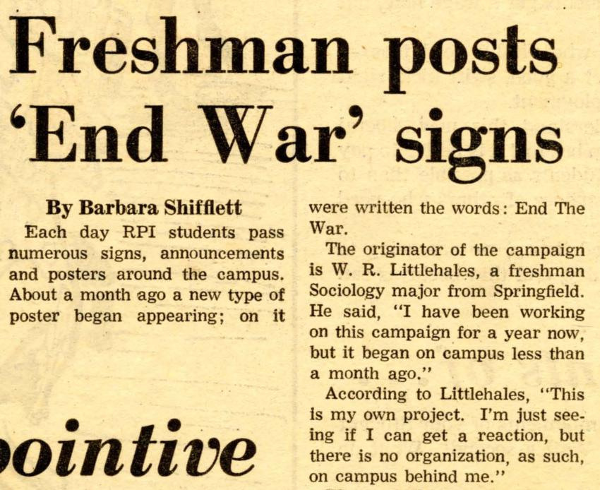

Slide 8
“The Human Grenade” & An MCV War Hero
An alumnus of MCV, Air Force Maj. Gen. James Humphreys (M.D. ‘39) worked as a field surgeon while Assistant Director of the U.S. Agency for International Development. On November 5, 1965, Humphreys and his assistants treated Nguyen Van Chinh, a Vietnamese farmer struck by a round from a grenade launcher. Lodged inside Chinh’s body under his right kidney, the three-inch projectile had not detonated. In a delicate surgery with forceps and clamps created from scrap metal in the makeshift medic bunker, Humphreys safely removed the grenade from Chinh’s body. The surgery made international headlines, and Humphreys won the Legion of Merit.

Slide 9
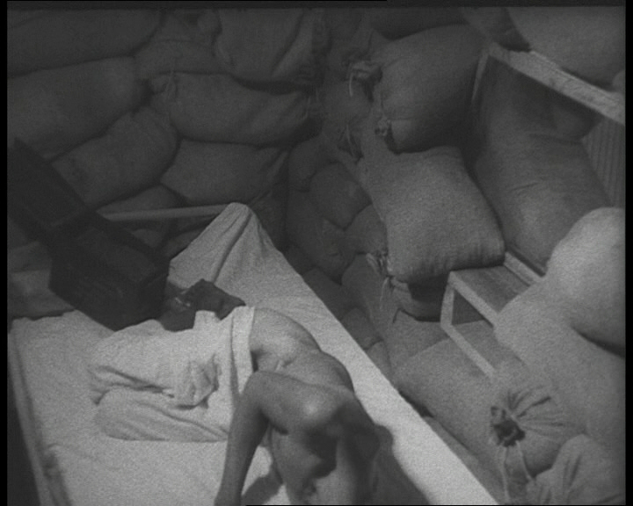
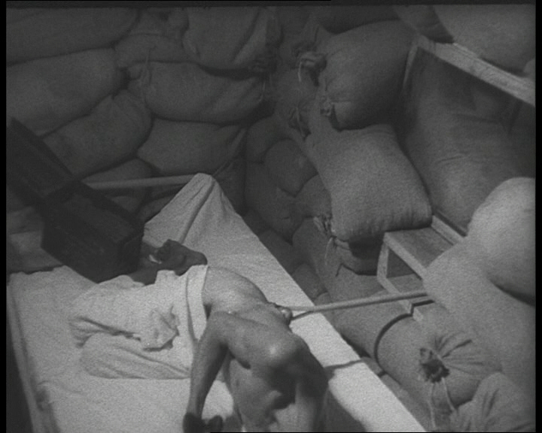
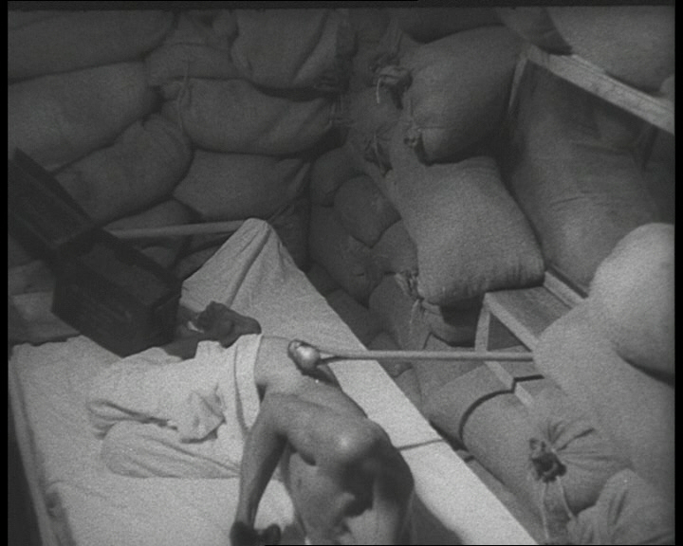
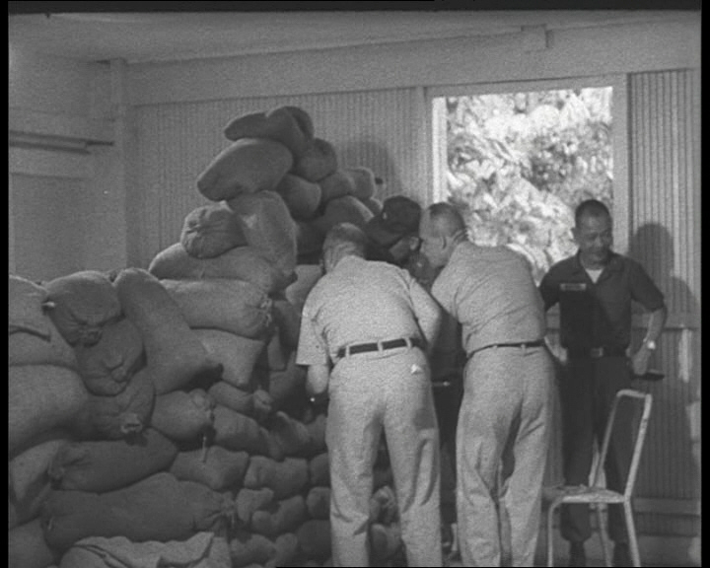
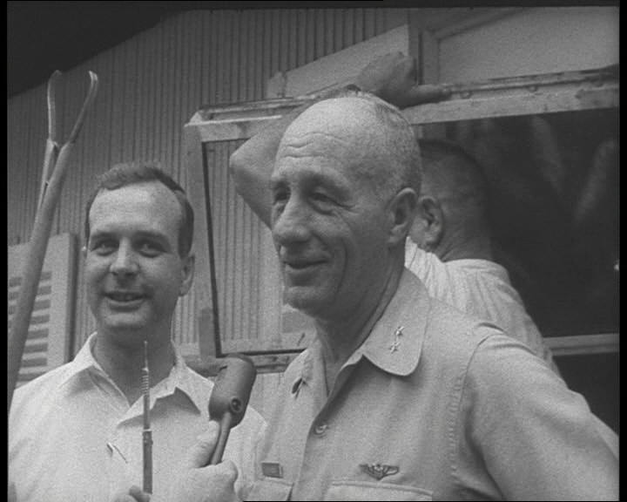
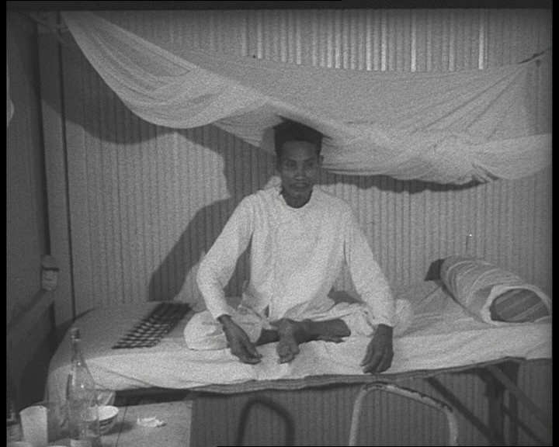

Slide 10
1968-1969: Turning Points
1968 marked two important turning points. First, RPI and MCV merged to form VCU with a total body of over 10,300 students. Campus publications reported that the largest percentage of Vietnam veterans in the state attended VCU. Second, the Tet Offensive, a coordinated attack by the North Vietnamese Army and the Viet Cong on multiple urban centers in South Vietnam, led more Americans to question the war effort. Along with increased controversy about the draft, the fallout from the Tet Offensive gave rise to more debate on campus. A small group of students joked about “burning puppies” at an upcoming demonstration to spark interest in the anti-war cause. Although the activists did not intend to harm a dog, an uproar ensued. The negative headlines drew a crowd, but some students said they became war supporters as a result. After the so-called Puppy Burn, campus demonstrations against the war became more common. For example, students staged multiple protests in October 1969 in support of the National Moratorium for Peace, including a march from VCU’s Monroe Park campus to the Virginia State Capitol where participants chanted the names of the villages bombed in Vietnam along with the names of all US war dead.

Slide 11
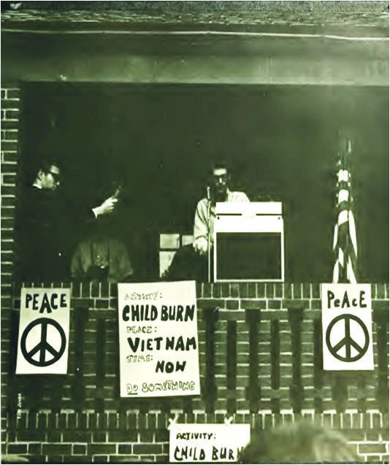
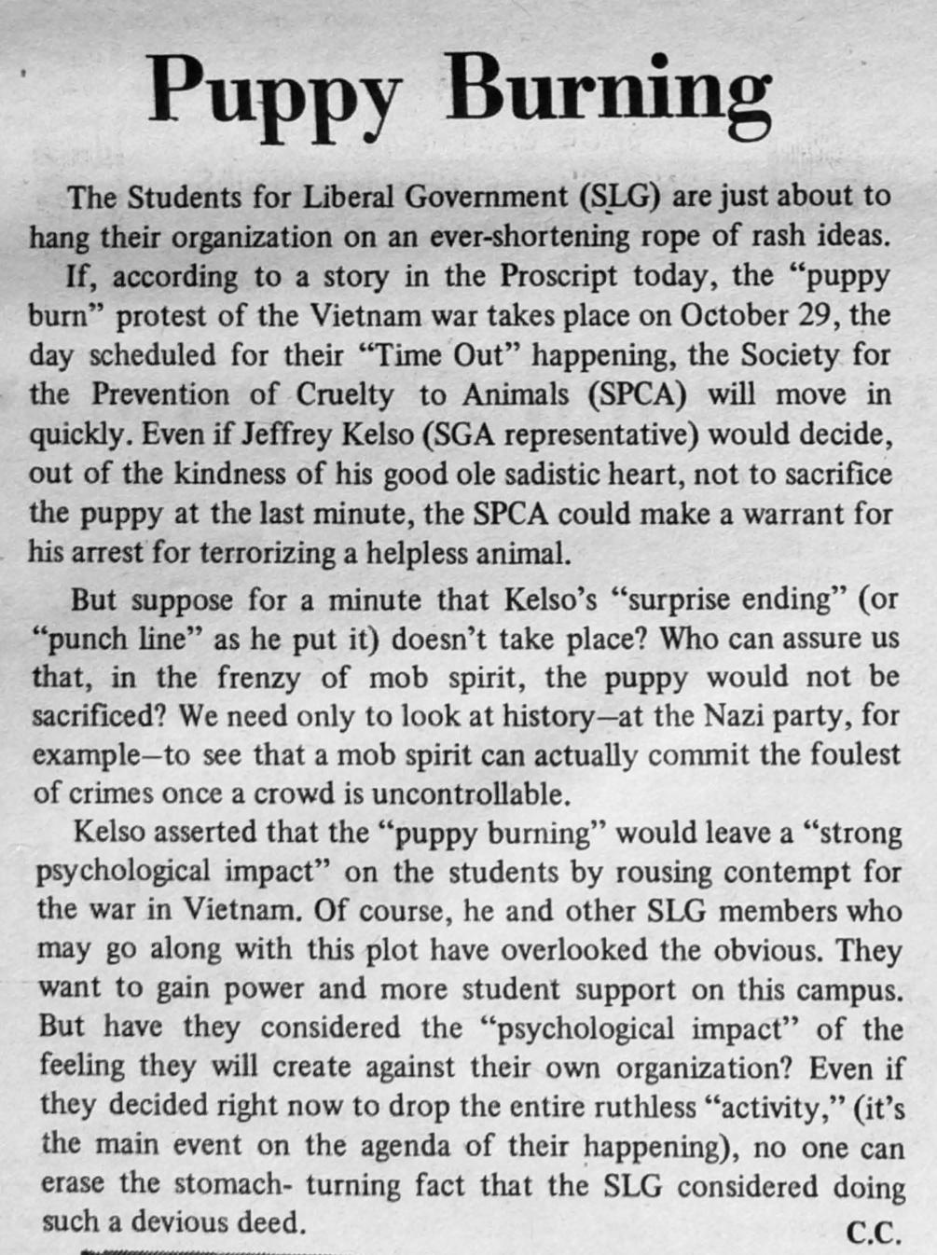

Slide 12
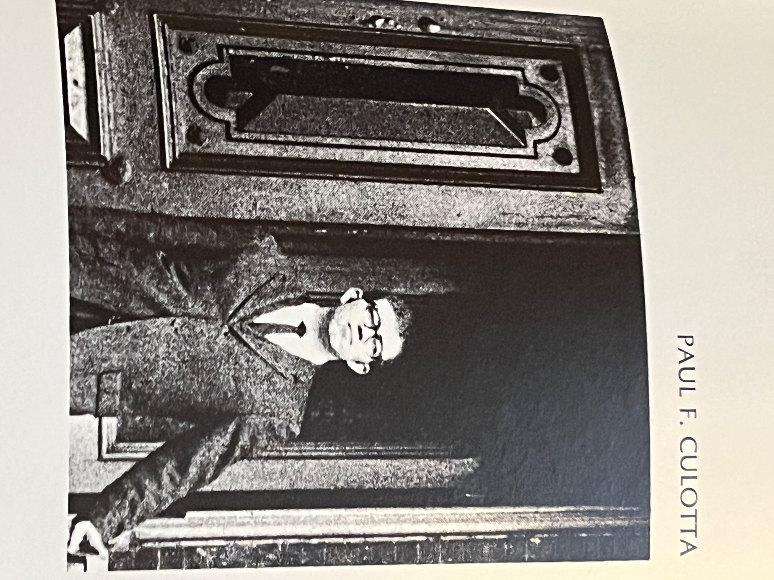
Oral History: Paul Culotta, B.A. ‘70
“I remember one [protest] in particular …They [Students for Liberal Government] had one that was really controversial. They were advertising that in this protest they were going to burn a puppy alive. Now everybody got really excited but not in a positive way, and I had a strong talk with Jeff [Kelso], ‘you guys can’t do this, you’re going to make people hate you.’ But this protest went on. It was well attended and at one point the city killed the power at Monroe Park in the gazebo. They cut it so the microphone wouldn’t work but the [SLG] had it all figured out with a generator and had it back up and running within a minute.
In the end, the protestors did not end up burning a puppy alive. My roommate, Jeff, made the final speech and admonished the crowd for thinking that they would actually do such a cruel thing. The crowd was upset about burning alive dumb animals but not the men who were dying in Vietnam for no reason. And I thought okay, you made a point and everything, not in a positive way…but they did make a point.”

Slide 13
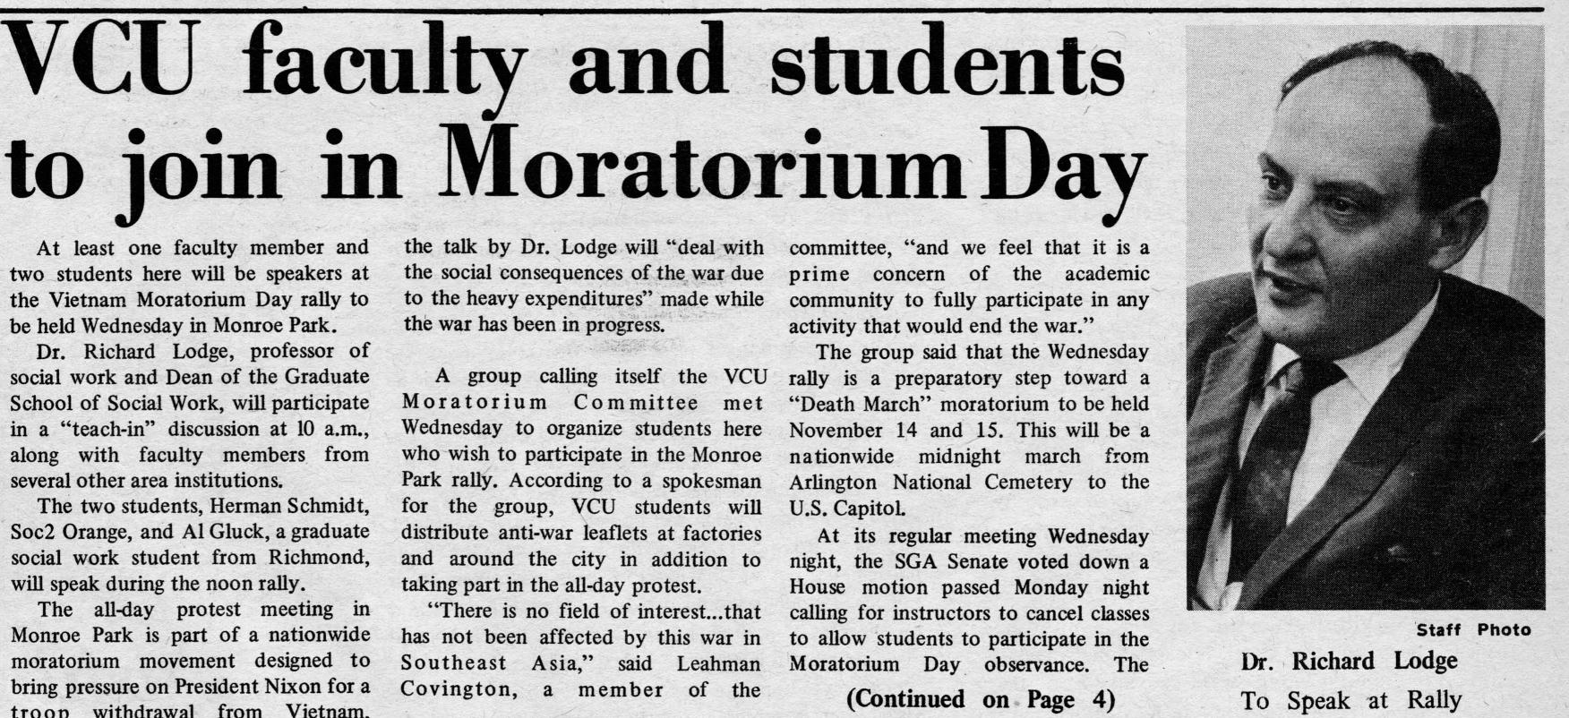
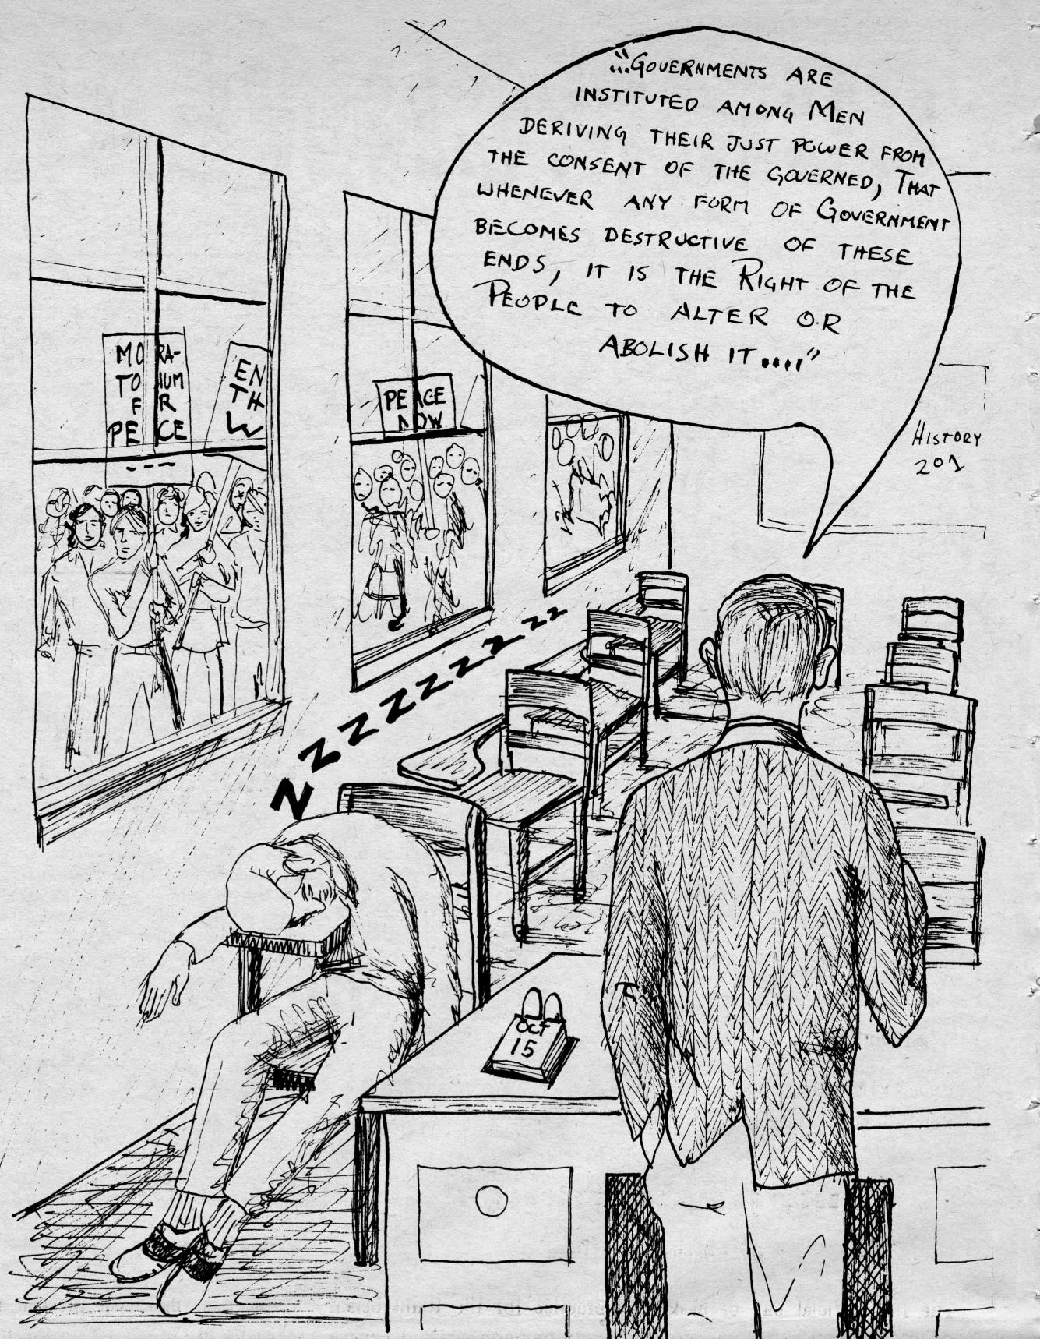
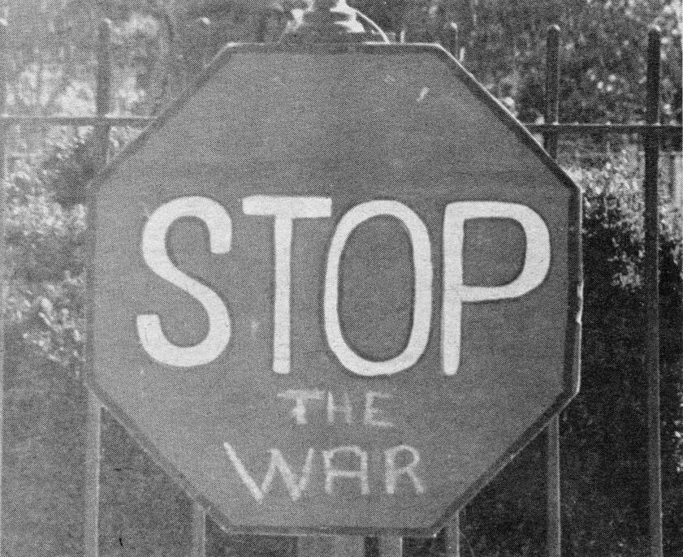

Slide 14
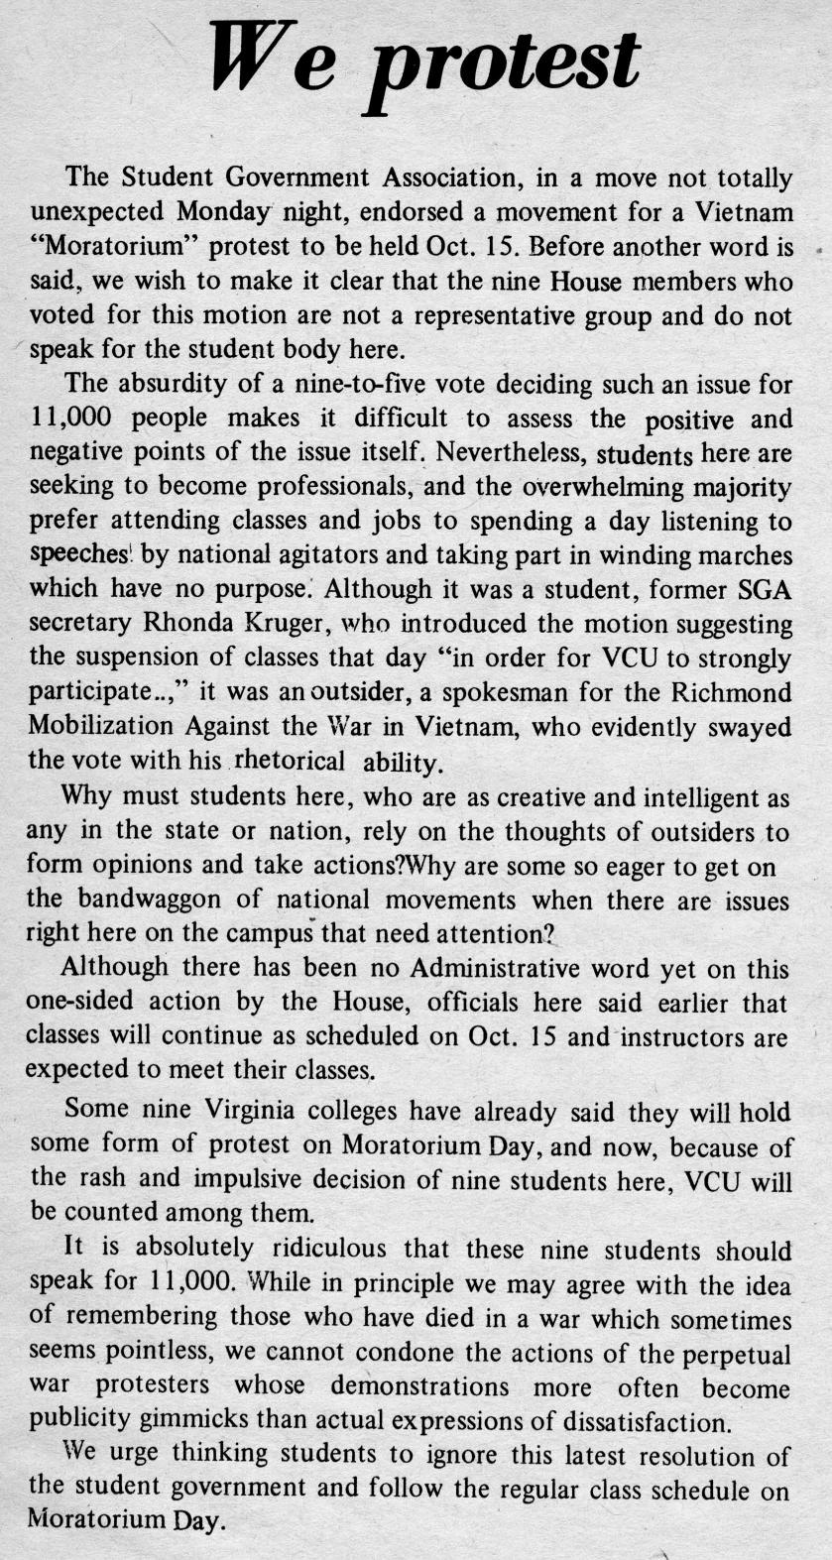
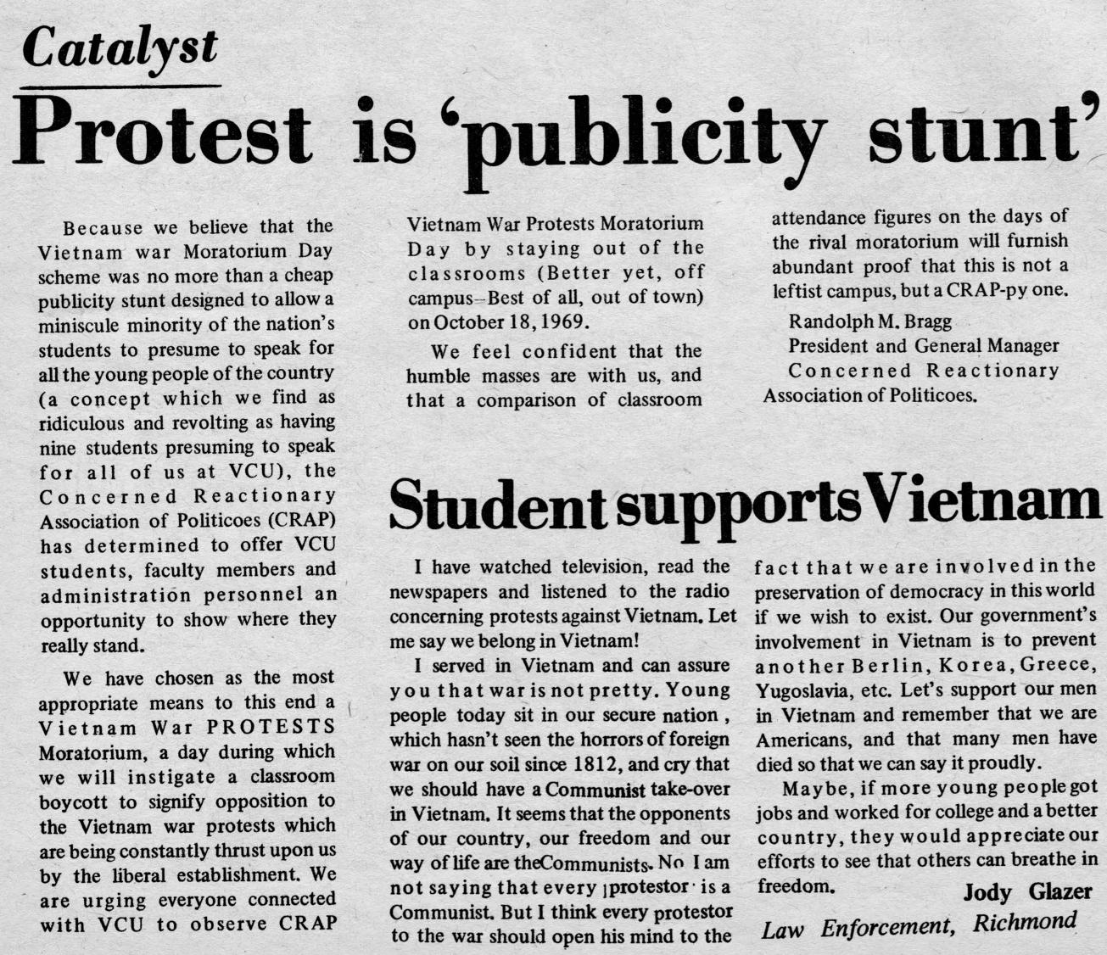

Slide 15
“Vietnam Lotteries” How did they serve?
Between 1964 and 1973, over 2.2 million Americans were drafted through a lottery system to fight in southeast Asia from an eligible 27 million men. A controversial touchstone throughout the war, draft critics pointed to college deferments and other legal loopholes as inherently unfair. Cartoonists mocked the Selective Service in campus publications. But draft evaders faced ostracization. Twenty-Five percent of total forces in country were draftees. Replaced in 1972 with an all-volunteer military, the last men drafted to service saw active duty in early 1973.

Slide 16
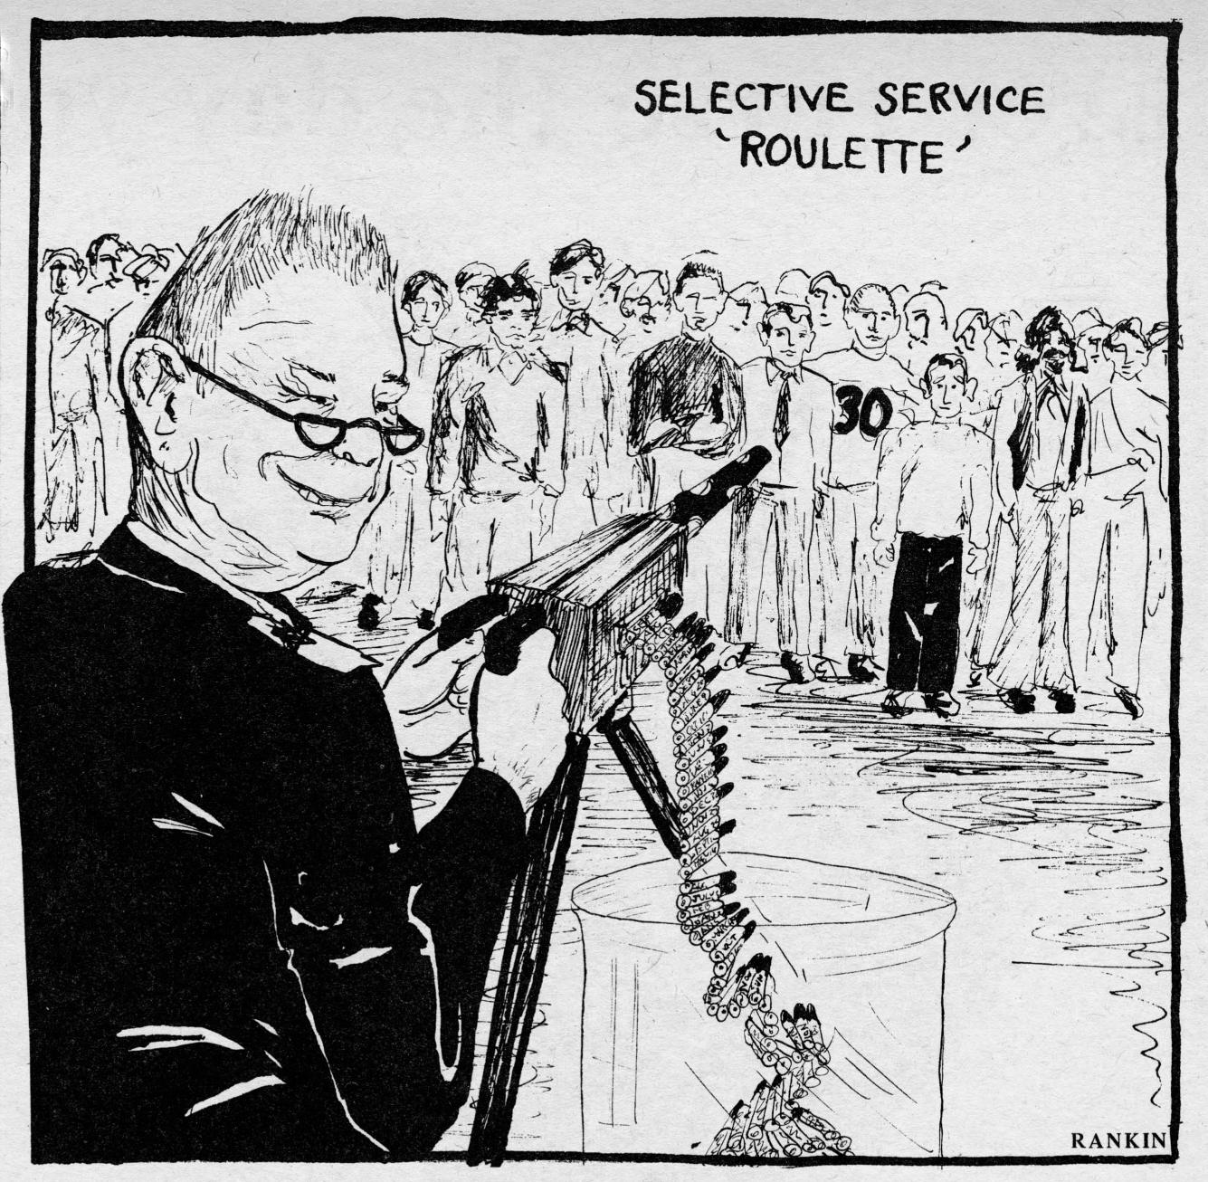
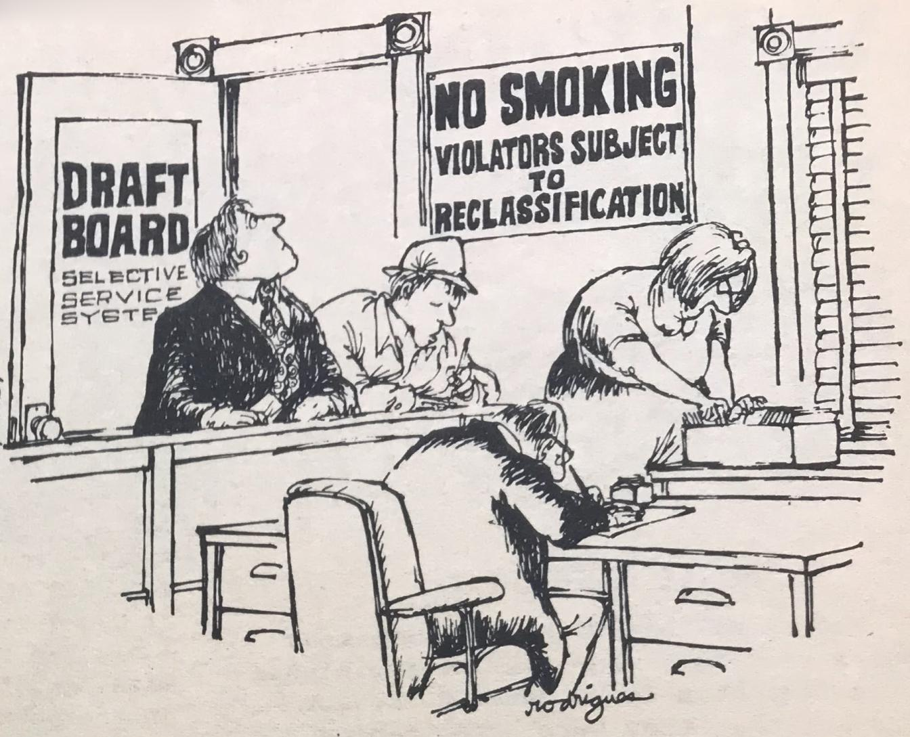

Slide 17
1970-1973: Peak of Debate
The war debate climaxed on campus in May 1970 in the wake of demonstrations at Kent State University, when Ohio National Guardsmen killed four students during protests against the invasion of Cambodia and the presence of ROTC on campus. When some college students called for a national strike, the VCU community vociferously debated in the school newspaper and at Student Government Association meetings about shutting down the campus. Ultimately, the university did not cancel classes, but offered students the ability to follow their consciences. In the meantime, a new Veterans Club formed at VCU in 1969 to aid male and female veterans in campus life, and students supported the Richmond Write Hanoi campaign seeking improved treatment for American prisoners of war.

Slide 18
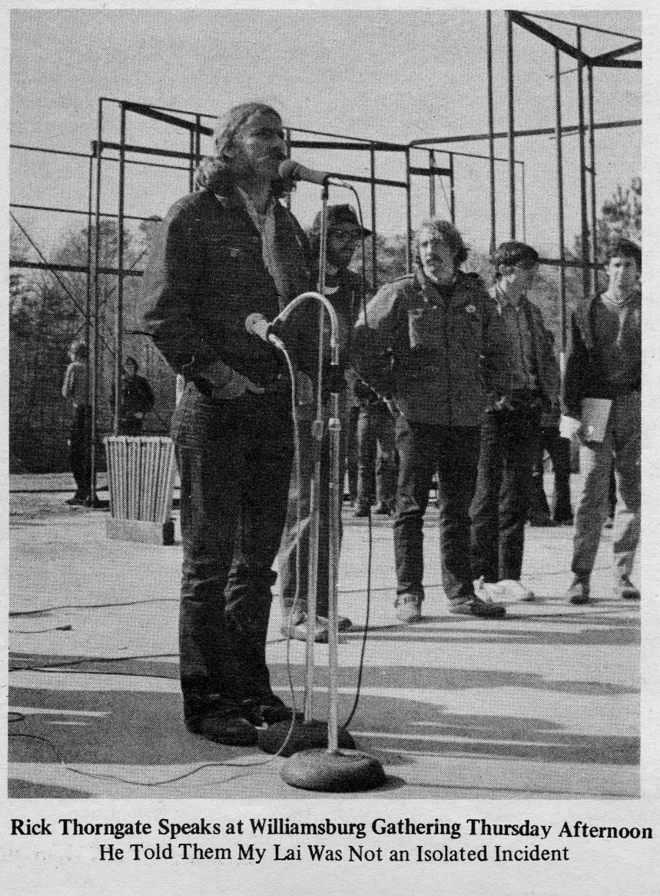
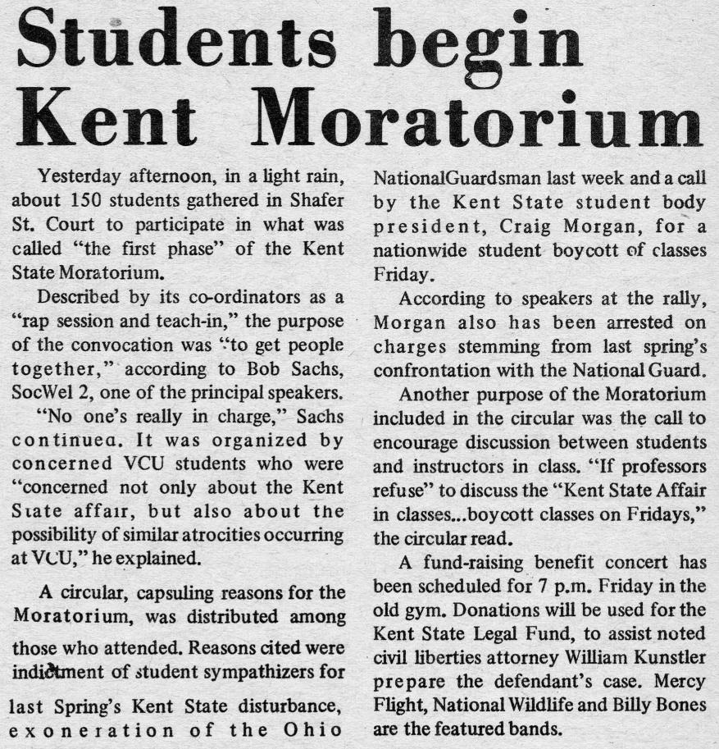
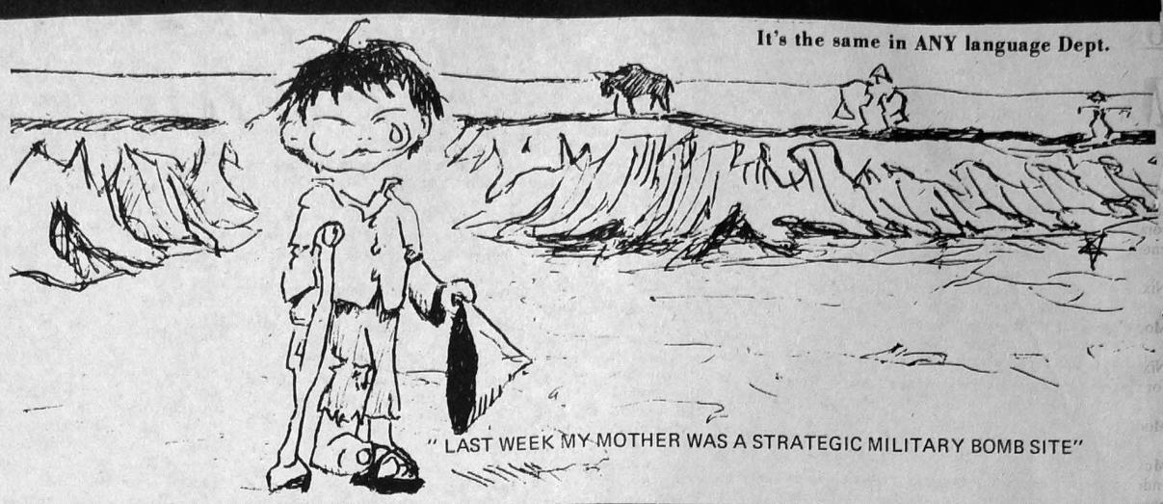

Slide 19
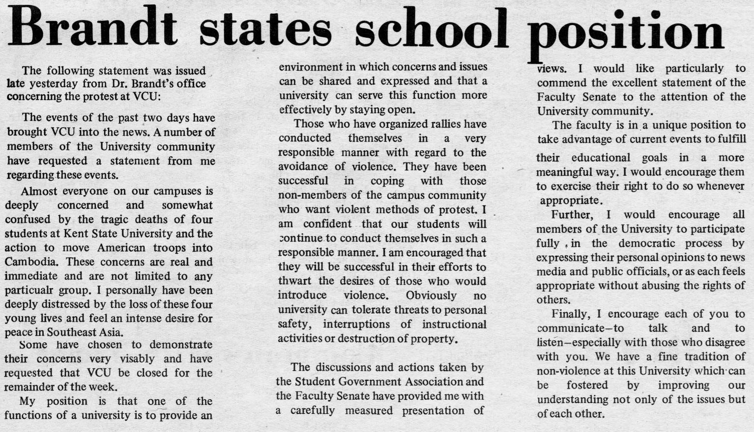
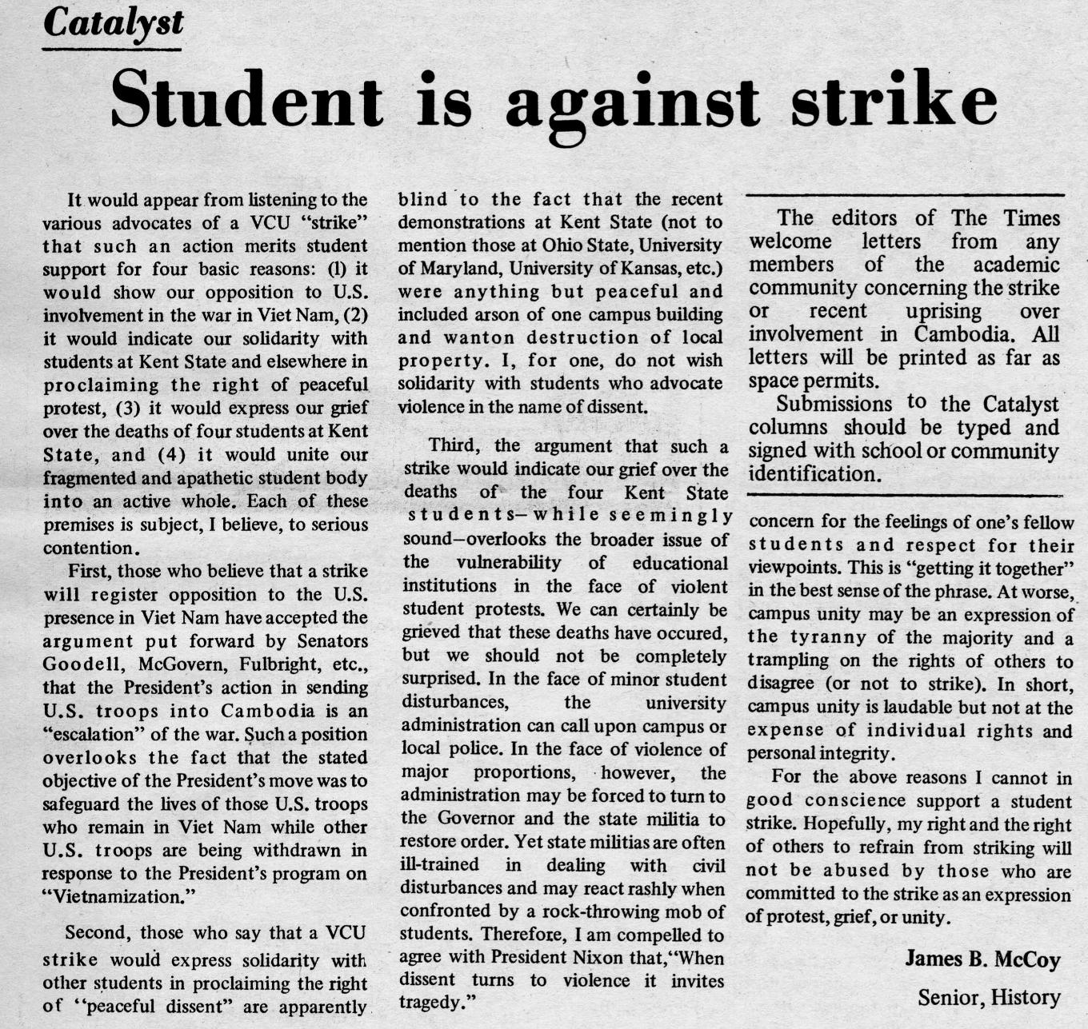

Slide 20
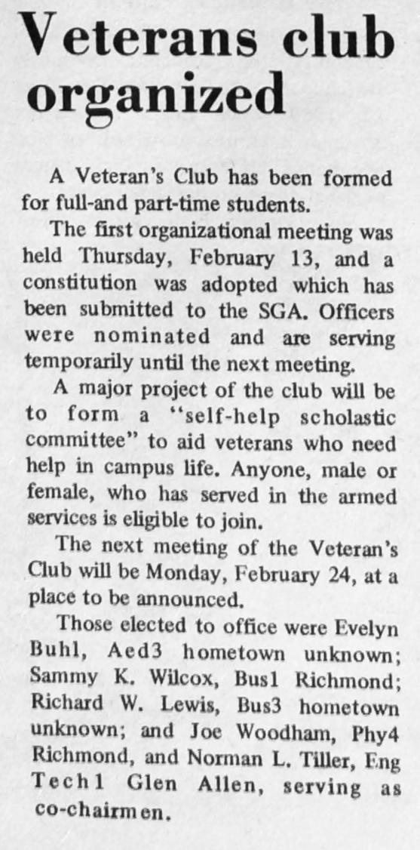
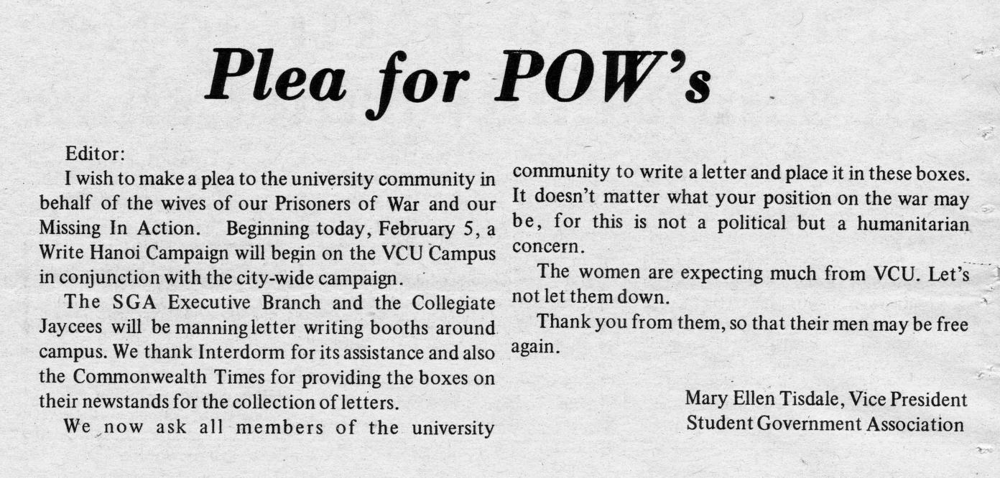
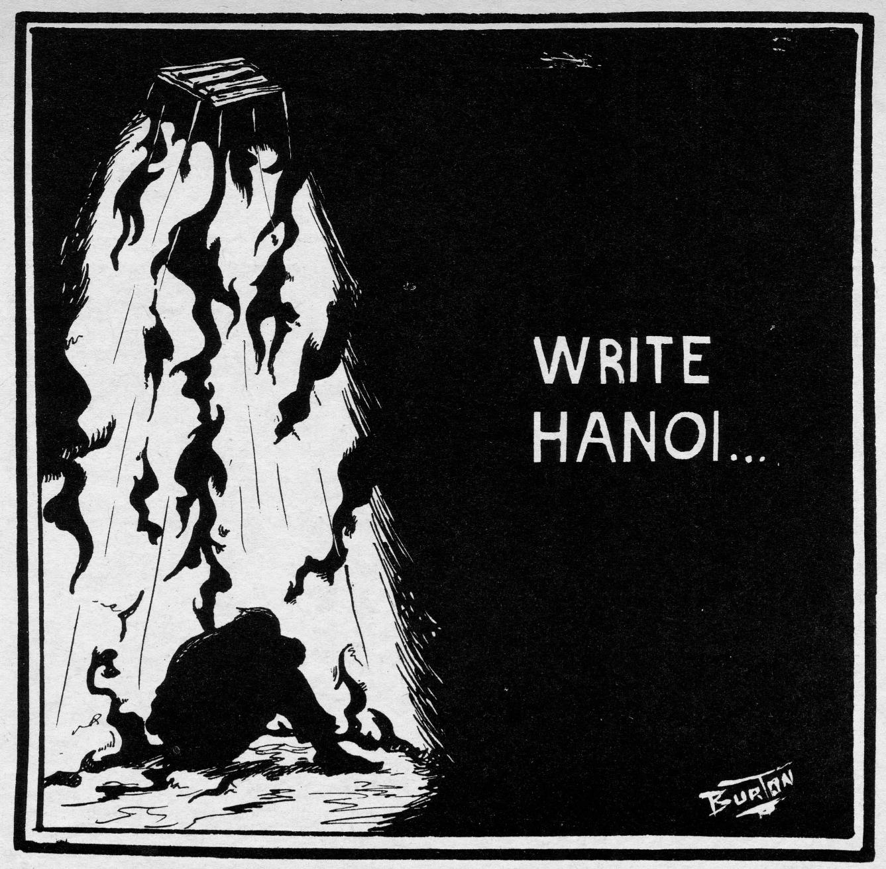

Slide 21
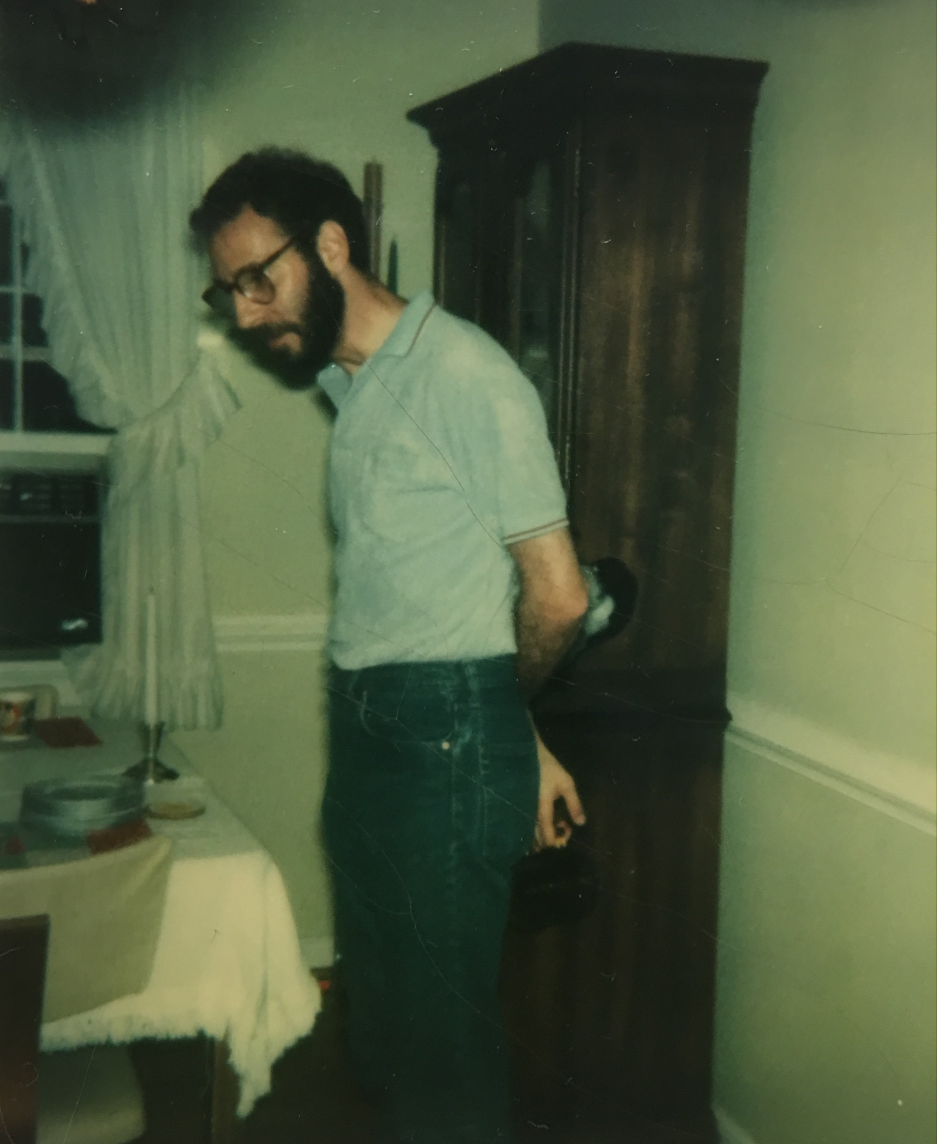
Oral History: Fred Wayne, B.A. ‘70
“Years later when [Secretary of Defense 1961-68] Robert McNamara was old and the war was over, he said along the lines of ‘You were looking at the fog of war and the blur was so you couldn’t see it was a civil war. It wasn't Communism taking over the world, it was a civil war that was their business and we should not have been involved.’ And so these words filtered out and no one wanted to go, so a lot of young men were going to Canada.”
“There was enough out there to cause a number of people, especially students, to reject the idea of why we were fighting in this country. College campuses were the ideal place to grow and be nurtured. We’re here to challenge ideas. You’re told to think something, and then you challenge. And that is a lot of what was going on here.”

Slide 22
History Professors Debate
During the 1972 presidential race, which focused on Vietnam War policy, two History professors debated the candidates in the campus newspaper.
Dr. William E. Blake defended Republican President Richard Nixon’s phased withdrawal and diplomatic initiatives. Professor Sandra M. Hawley supported Democratic candidate George McGovern’s calls for immediate withdrawal of American forces from South Vietnam and amnesty for “draft dodgers.” Nixon easily won re-election, but his involvement in the Watergate scandal undermined American support for South Vietnam.

Slide 23
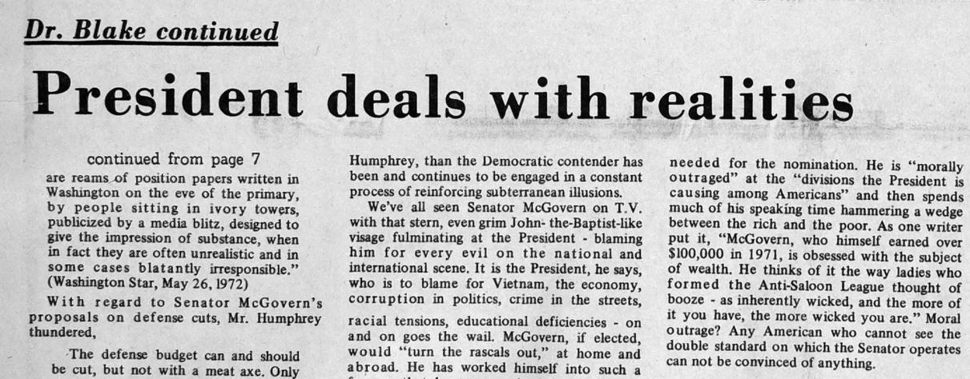
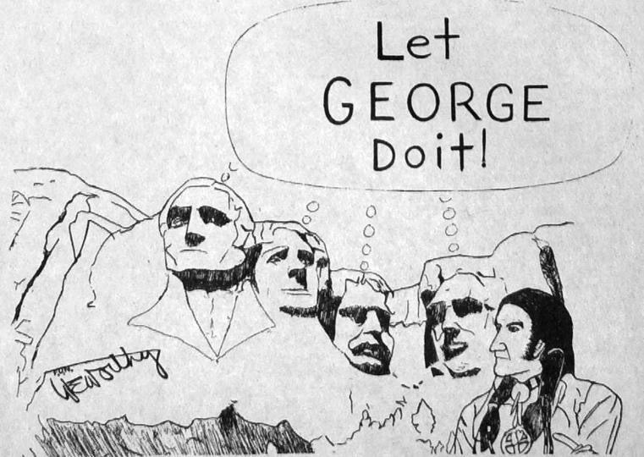
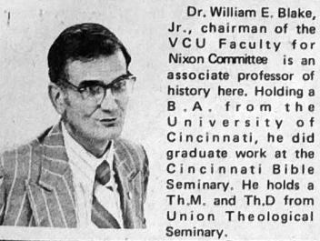
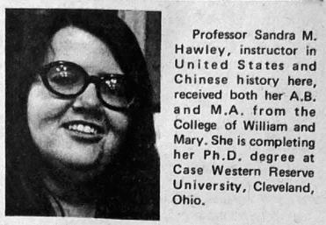
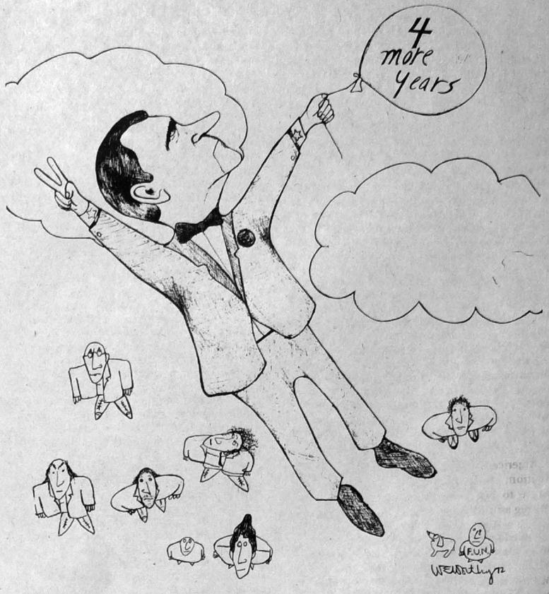
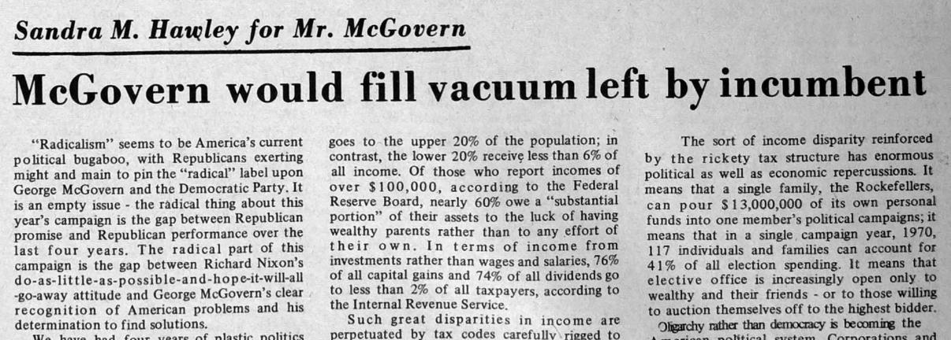

Slide 24
Aftermath: Legacy of the Vietnam War on Campus
The Paris Peace Accords, signed January 27, 1973, ended US military involvement in the Vietnam War, and American financial support for South Vietnam waned. On April 30, 1975 communist forces invaded Saigon, defeating the South Vietnamese government. Ousted South Vietnamese vice president Gen. Nguyen Cao Ky visited Richmond in 1975, describing the violent aftermath of revolution. Hundreds of refugees and their descendants attended VCU, and a Vietnamese Student Association formed in 1979. Military veterans, activists on both sides of the debate, and Vietnamese Americans continue to perceive the war as a formative time in their lives.

Slide 25
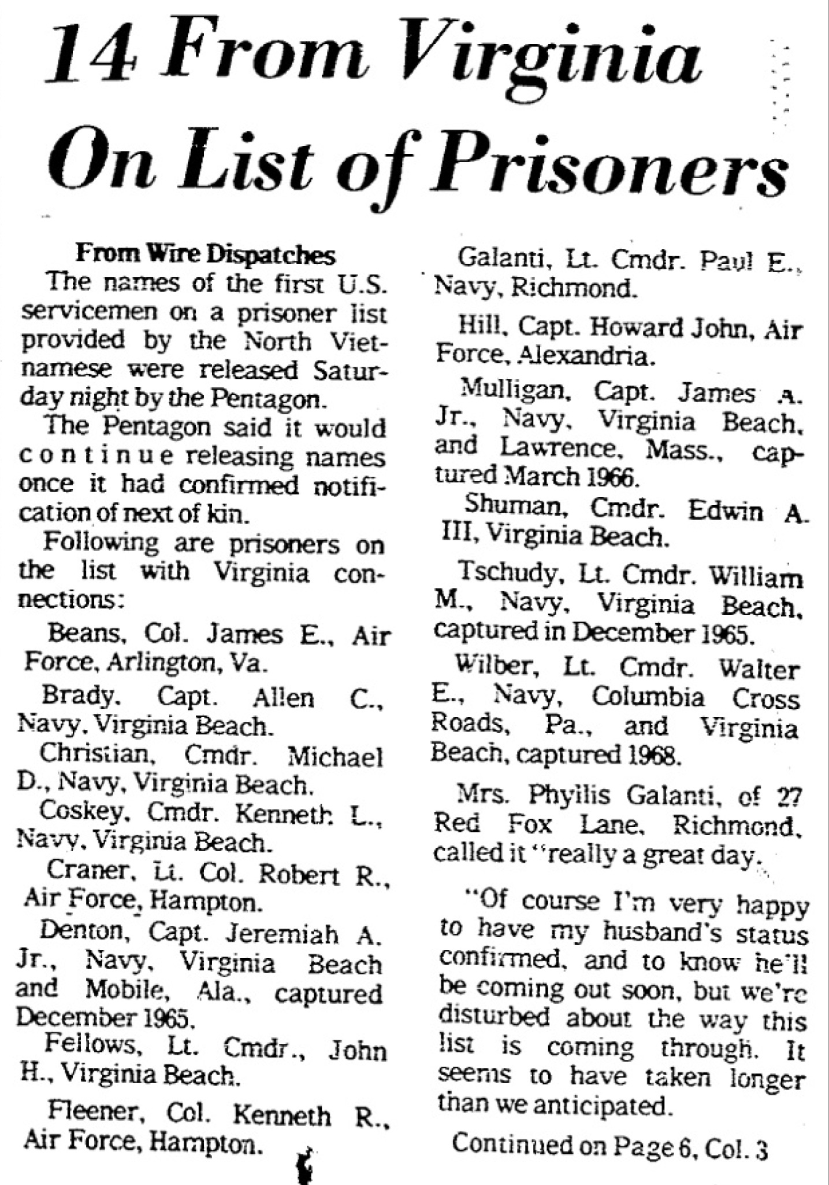
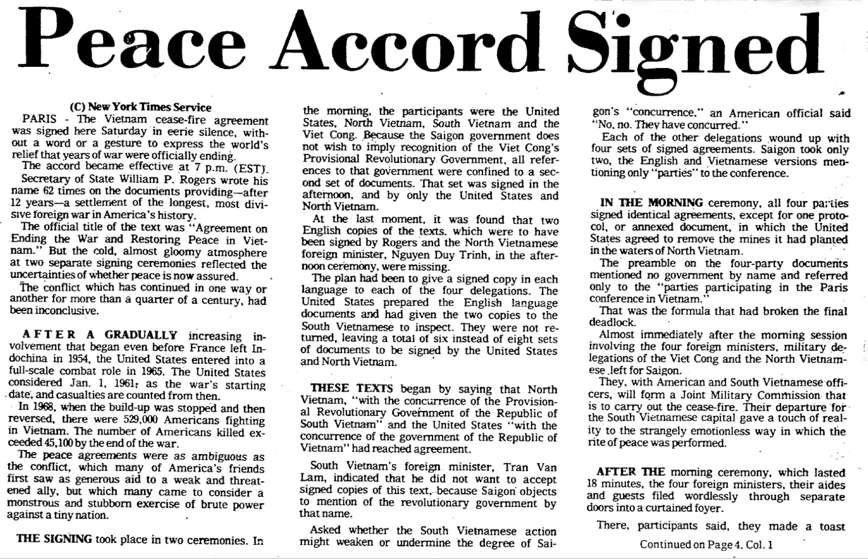
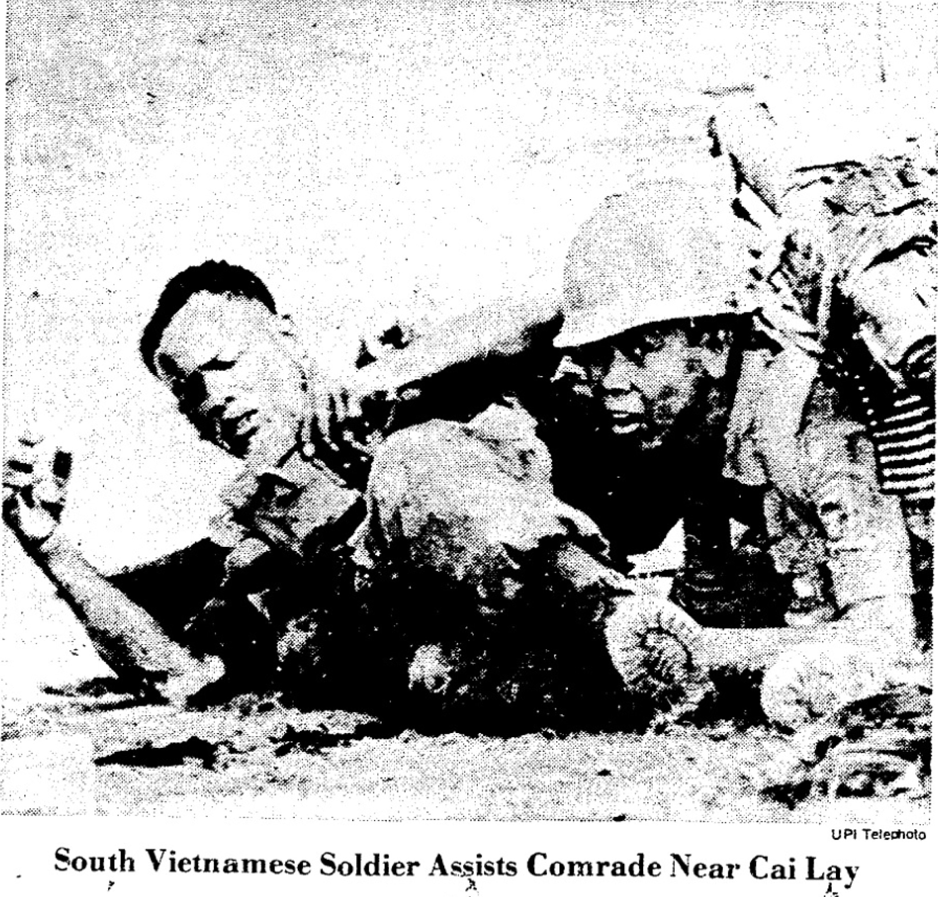

Slide 26
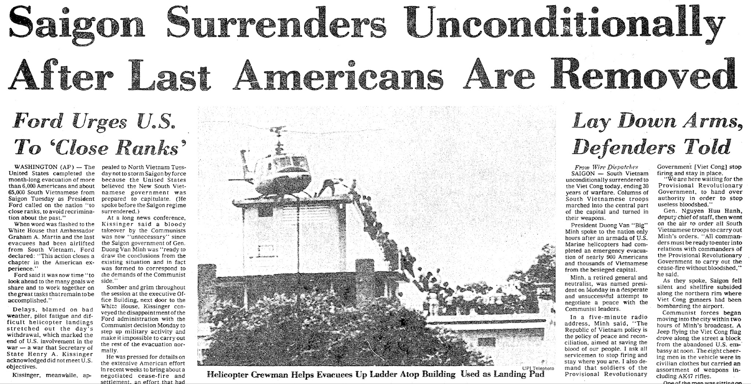

Slide 27
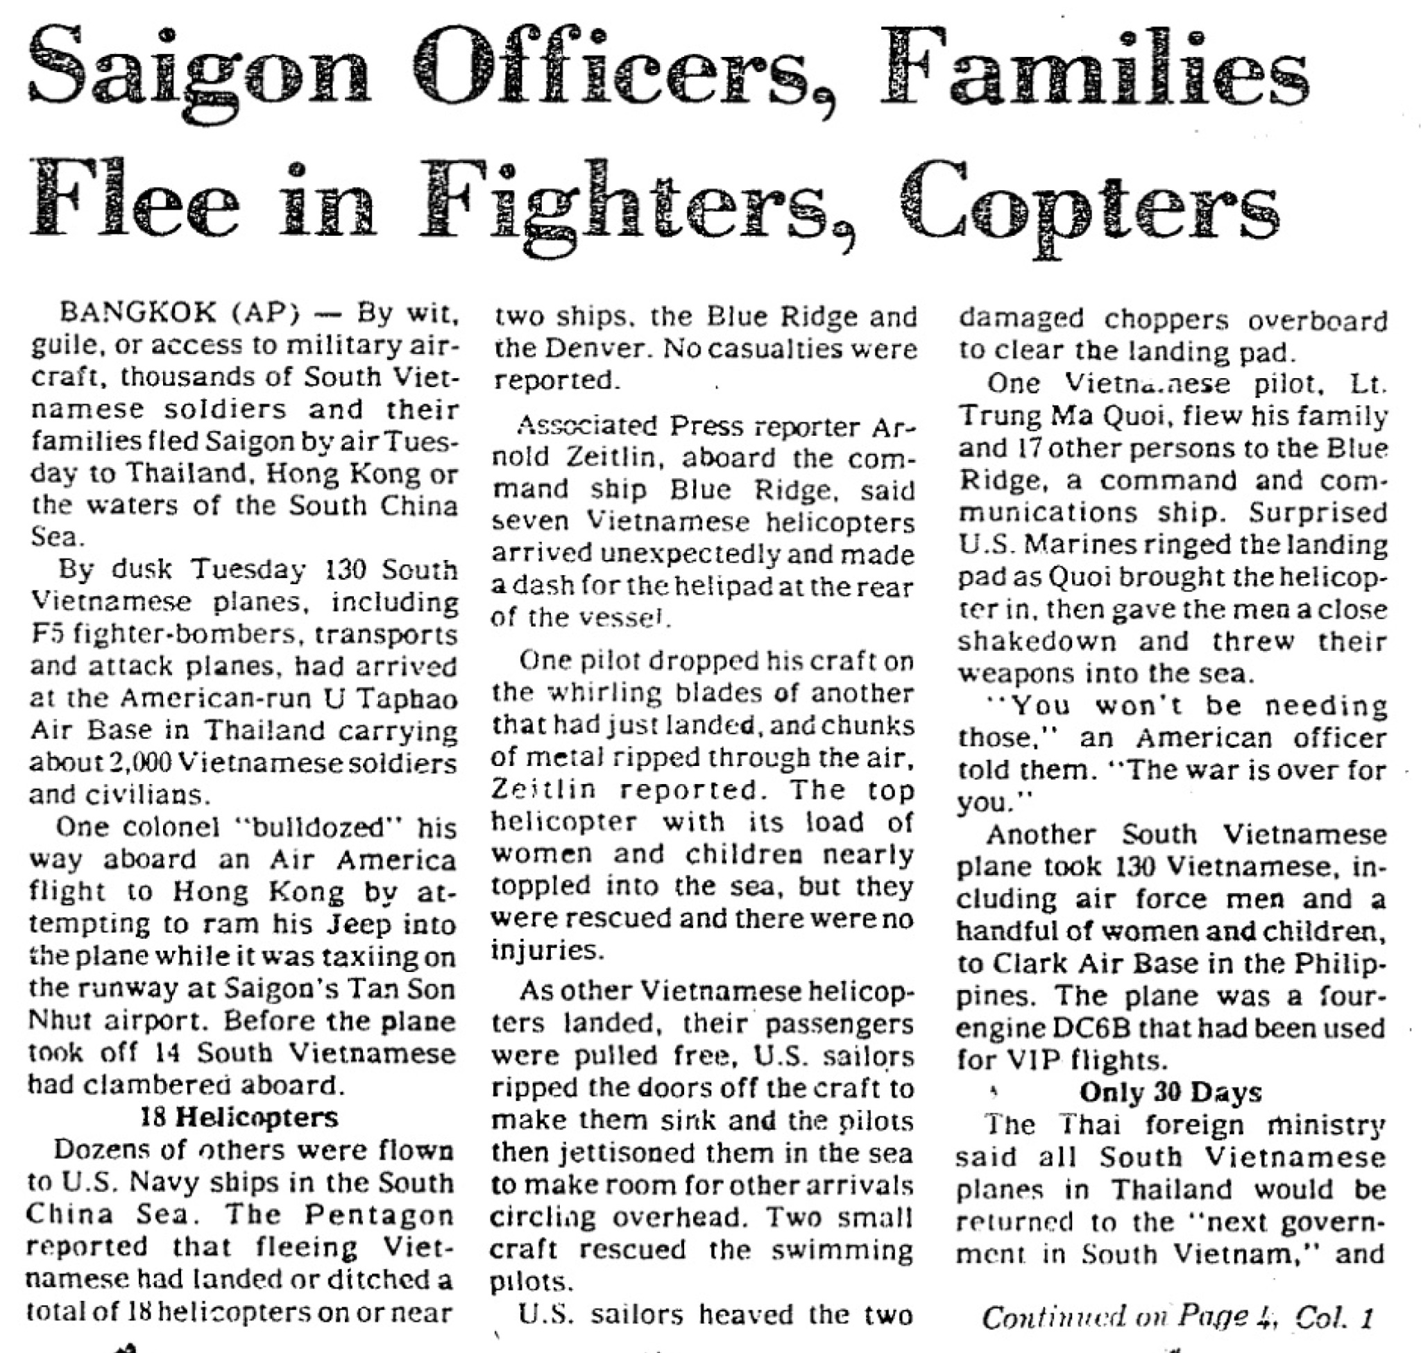
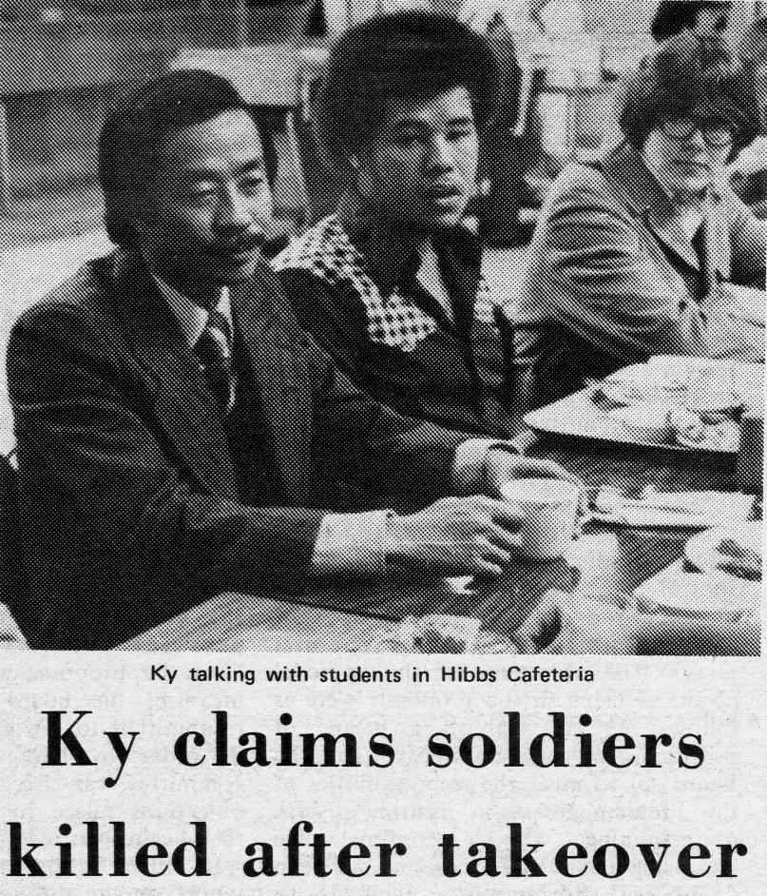
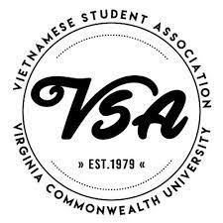

Slide 28
Sources
1965-68: The Build Up
“Students Favor Keeping Troops in Vietnam,” Proscript, October 29, 1965
“Students Donate 230 Pints to Viet Nam Blood Drive,” Proscript, March, 18, 1966
“Gen. Maxwell Taylor is Schedule to Speak at Next Convocation,” Proscript, October 11, 1967
“The Washington Peace March,” The Richmond Chronicle, October 21, 1967
“Saturday, October 21: The Washington Peace March,” The Sunflower, November 2, 1967
“Sgt. Pepper’s Peace Parade,'' The RIchmond Chronicle, December 23, 1967
“Freshman Posts ‘End War’ Signs,” Proscript, March 8, 1968
“Tech Sled Held,” Proscript, November 8, 1968
“The Human Grenade” & An MCV War Hero
“Explosive in Vietnamese Soldier’s Back–Live Grenade Removed By Henrico Surgeon,” Richmond Times-Dispatch, November 5,
1965
“‘Easy’ Surgeon Reports after Removing Grenade,” Richmond Times-Dispatch, November 6, 1965
“Dr. Humphreys Returns Home from Viet Nam,” Richmond Times-Dispatch, December 25, 1965
“Class News,” The Scarab, August, 1967

Slide 29
Sources, ctd.
1968-69: Turning Points
“RPI-MCV Consolidation Given Assembly Approval,” Proscript, February 16, 1968
“Anti-Vietnam War Protest, October 1968, Monroe Park,” VCU Libraries Gallery, accessed March 31, 2023,
https://gallery.library.vcu.edu/items/show/92522
“We Protest” Commonwealth Times, October 8, 1969
“Puppy Burn,” Proscript, October 10, 1968
“M-Day [Moratorium Day] Part 2: more crowds, more dissent, more hope” Richmond Chronicle, November 1969
“Veterans Club Organized,” Proscript, February 21, 1969
Untitled political cartoon, Commonwealth Times, October 15, 1969
“VCU faculty and students to join in Moratorium Day,” Commonwealth Times, October 10,1969
Harry Long, “Let’s Support Moratorium,” Commonwealth Times, October 17, 1969
Wayne Eaton, “M-Day: Con,” Commonwealth Times, October 17, 1969
“Moratorium Day Crowd is Peaceful,” Commonwealth Times, October 17, 1969
Randolph M. Bragg, “Protest is Publicity Stunt,” Commonwealth Times, October 17, 1969
Jody Glazer, “Student Supports Vietnam,” Commonwealth Times, October 17, 1969
“Nixon’s Vietnam War Policy Draws Support from Faculty,” Commonwealth Times, November 7, 1969
Chris Ellis, “So Many…And It Was Peaceful,” November 20, 1969
Bill Thomas and Steve Gilbert, “The Pacifiers,” Richmond Chronicle, May 1970

Slide 30
Sources, ctd.
“Vietnam Lotteries” How did they serve?
“SOC Draft Counseling,” Sunflower, February 22, 1968
Rankin, “Selective Service ‘Roulette,’” Commonwealth Times, December 3, 1969
Alan Ehli, “Draft Beat,” Richmond Chronicle, May 15-30, 1969
Rodrigues, “No Smoking, Violators subject to reclassification,” Richmond Chronicle
“The Military Draft During the Vietnam War,” Resistance and Revolution, https://michiganintheworld.history.lsa.umich.edu/antivietnamwar/exhibits/show/exhibit/draft_protests/the-military-draft-during-the-#:~:text=During%20the%20Vietnam%20War%20era,eligible%20pool%20of%2027%20million.
Vietnam War Stats, https://post3legion.org/Vietnam_Statistics.pdf
“Laird Ends Draft Use,” Richmond Times-Dispatch, January 28, 1973

Slide 31
Sources, ctd.
1970-1973: Peak of Debate
“Faculty says no to strike,” Commonwealth Times, May 6, 1970
Jay Mangan,“Catalyst: On Kent killings,” Commonwealth Times, May 6, 1970
Sue Franciso, “The Observer: Nixon made necessary move!” Commonwealth Times, May 6, 1970
“Brandt states school position,” Commonwealth Times, May 7, 1970
James B. McCoy, “Catalyst: Student is against strike,” Commonwealth Times, May 7, 1970
“Students begin Kent Moratorium,” Commonwealth Times, October 23, 1970
Burton, “Write Hanoi” political cartoon; accompanied by Mary Ellen Tisdale, “Plea for POW’s,” Commonwealth Times, February 5, 1971
“War, Population Touched in Convocation Speech,” Commonwealth Times, February 12, 1971
“2,500 gather; petition for peace,” Commonwealth Times, March 12, 1971
“Virginia veterans join peace movement,” Commonwealth Times, April 23, 1971
Cheryl Fricke and Kenneth Nygren, “Don’t write Hanoi or apply labels,” Commonwealth Times, February 19, 1971
“Last Week My Mother Was a Strategic Bomb Site,” Commonwealth Times, September 21, 1972
C. E. Moore, “People’s Editorial: You Ask Me About Vietnam,” Commonwealth Times, September 22, 1971
“GI Bill explained here,” Commonwealth TImes, October 27, 1971

Slide 32
Sources, ctd.
History Professors Debate
William Blake, “From illusion to reality or Out of the cave,” Commonwealth Times, October 19, 1972
Sandra M. Hawley, “McGovern would fill vacuum left by incumbent,” Commonwealth Times, October 19, 1972
Author unknown, “4 more years,” Commonwealth Times, October 19, 1972
Author unknown, “Let GEORGE Do it!” Commonwealth Times, October 19, 1972
Aftermath: The Legacy of the Vietnam War on Campus
“The Last Day in Vietnam: Peace is Only on the Radio,” Richmond Times-Dispatch, January 23, 1973
“14 From Virginia On List of Prisoners,” Richmond Times-Dispatch, January 23, 1973
“Fighting Continues After Cease-Fire,” Richmond Times-Dispatch, January 23, 1973
“Peace Accord Signed,” Richmond Times-Dispatch, January 28, 1973
“Saigon Officers, Families Flee in Fighters, Copters,” Richmond Time-Dispatch, April 30, 1975
“The American Way Lured Some Right to the Last,” Richmond Time-Dispatch, April 30, 1975
“Ky Claims Soldiers Killed after Takeover,” Commonwealth Times, December 5, 1975
Logo, Vietnamese Student Association (VSA) at VCU, established 1979
Oral Histories
Paul F. Culotta, Interviewed by Ellliott Martin, April 20, 2023
Fred Wayne, Interviewed by Elliott Martin, April 21, 2023
Images courtesy VCU Digital Collections, Fred Wayne, News Bank: America’s News, and Vietnamese Student Association

