Slide 1
Research Community On-Site Toolkit Training Session
July 18, 2023

Slide 2
Agenda
Introductions & HRPP Transformation Overview
What is the HRPP Toolkit?
Resource Overview
RAMS-IRB Changes and Protocol-Based Applications
Ancillary Review Requirements: HRP-309 - Ancillary Review Matrix
Protocol Development Using HRPP Toolkit
Break & Lunch
Informed Consent
Office Hours: Research Community Q&A
Notes:
Sandy, Tom: Intro and HRPP Transformation Overview
Christina: Protocol Development
Brandy: Informed Consent

Slide 3
INTRODUCTIONS
HRPP Transformation Team

Slide 4
Introductions
HRPP Transformation Team
Sanjur Brooks, DPS, VCU HRPP Director
Lea Olverson, MS, VCU HRPP Deputy Director
Tom Bechert, MBA, MS, CIP, Huron Consulting Group, Sr. Director
Christina Moord, CIP, Huron Consulting Group, Sr. Associate
Brandy Stoffel, JD, CIP, Huron Consulting Group, Associate

Slide 5
HRPP TRANSFORMATION OVERVIEW

Slide 6
HRPP Transformation Overview
Goals
Transform the VCU Human Research Protection Program (HRPP) to improve overall compliance with regulations and industry best practices, enhance efficiency and effectiveness for the research community, and support the education of various stakeholders to ensure the protection of human subjects in research at VCU.
Compliance
Align the VCU HRPP to support and enhance compliance through implementation of the Huron HRPP Toolkit.
Efficiency
Implement business processes that create efficient review of research to support the innovative research work conducted at VCU.
Training
Teach the IRB personnel and members efficient and effective practices. Onboard new personnel to support IRB leadership while ensuring high standards.
Effectiveness
Provide ongoing support, modeling, and mentorship for these stakeholders to secure these learnings for sustainability long after the project ends.

Slide 7
HRPP Transformation Overview
IRB Transformation
Phase 1: HRPP Toolkit Onboarding, Training and Mentorship (February – June)
Phase 2: Full Toolkit Go-Live, Reviewer Mentorship and Support (July – October)
Phase 3: Post-IRB System Implementation Go-Live HRPP Toolkit Support (November – February)
Anticipated Deliverables for Phases 1-3:
PI’s and Study Teams
IRB Members
IRB Staff
Project plan
Project charter
VCU customized HRPP Toolkit
HRPP Toolkit training materials for IRB staff and IRB members
Communications to support project and change management
Proposed IRB staffing model
Proposed IRB committee flex model
Materials to support project committee/group meetings

Slide 8
HRPP Transformation Overview
What is the HRPP Toolkit?

Slide 9
What is the HRPP Toolkit?
The HRPP Toolkit is a comprehensive set of workflows, standard operating procedures, checklists, worksheets and templates:
Implemented by many human research protection programs of all sizes.
The HRPP Toolkit was designed with the following concepts in mind:
Maximum regulatory flexibility consistent with compliant procedures;
Easy to follow, non-redundant procedures;
Focus on business process and IRB workflow;
Use of documents to support consistent IRB applications and reviews; and
Support application of ethical principles.

Slide 10
What is the HRPP Toolkit?
SOPs (~37)
Examples: Intake, Pre-Review, Non-Committee Review, IRB Meeting Conduct, Investigations
Worksheets (~23)
Examples: Exempt determination, Criteria for Approval, Emergency Use
Checklists (~15)
Examples: Pre-Review, Non-Committee Review, Children, Waiver of Consent Process
Process Maps
Examples: Flowcharts for Intake, Non-Committee Review and Convened IRB
Templates (~38)
Examples: Consent document, Protocol, Minutes, Approval letters
Other Resources
Examples: Investigator Manual, HRPP Plan

Slide 11
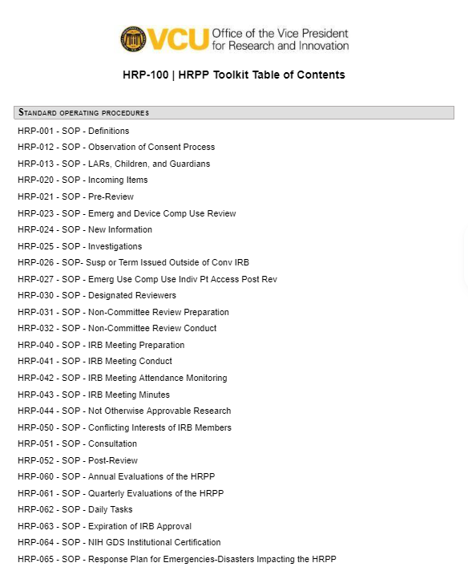
What is the HRPP Toolkit?
Use HRP-100 - Table of Contents to navigate the documents in the Toolkit and readily identify tools for protocol development and criteria for approval.

Slide 12
HRPP Transformation Overview
Resource Overview

Slide 13
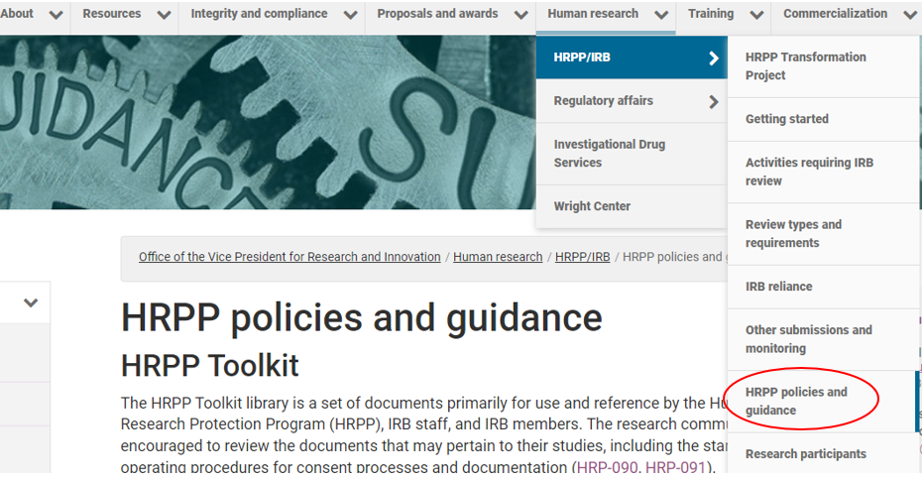
Resource Overview
HRPP Website
Revised HRPP website
FAQs
HRPP Blog: research community training sessions

Slide 14
Resource Overview
HRP-103 – Investigator Manual
A “How-To” manual for study teams
Outlines researcher responsibilities for conducting research at VCU
Identifies activities requiring IRB review
Specifies qualification and training requirements
Provides submission, protocol and consent guidance
Identifies regulatory considerations: consent requirements, levels of review, criteria for approval

Slide 15
HRPP Transformation Overview
RAMS-IRB Changes and
Protocol-Based Applications

Slide 16
RAMS-IRB Changes and Protocol-Based Applications
RAMS-IRB Changes
A new path for research projects or clinical investigations was implemented in June that minimizes administrative burden by reducing the number of smartform fields investigators need to complete in RAMS-IRB with the required protocol upload.
A study status change in RAMS IRB to “deferred” requires a response from the study team for reconsideration by the board. A status change to “tabled” requires no action by study team; the submission will be reviewed at the next available IRB meeting.

Slide 17
RAMS-IRB Changes and Protocol-Based Applications
Protocol Based Application
Protocol required for “Research Project or Clinical Investigation” pathway and “Treatment Use (Expanded Access)” in RAMS-IRB
HRP-503 – TEMPLATE Protocol
HRP-503a – TEMPLATE SBS Protocol

Slide 18
RAMS-IRB Changes and Protocol-Based Applications
Protocol Based Application
HRP-508 - Site Supplement is required for all studies involving a sponsored protocol
Required as part of the submission to VCU when applying to rely on external IRB
May not be reviewed by the external IRB

Slide 19
RAMS-IRB Changes and Protocol-Based Applications
Protocol Based Application
Protocol NOT required for Emergency Use or Not Human Subject Research (NHSR) pathways in RAMS-IRB

Slide 20
HRPP Transformation Overview
Ancillary Review Requirements: HRP-309 - Ancillary Review Matrix

Slide 21
Ancillary Review Requirements
HRP-309 – WORKSHEET Ancillary Review Matrix
Ancillary Reviews are reviews by other compliance groups or individuals that are in addition to IRB approval.
HRP-309 Ancillary Review Matrix identifies other reviews which may be needed and provides contact information for those other offices

Slide 22
PROTOCOL DEVELOPMENT USING THE HRPP TOOLKIT

Slide 23
Protocol Development Using the HRPP Toolkit
Tools
HRP-503 - TEMPLATE PROTOCOL
HRP-100 - HRPP Toolkit Table of Contents
Worksheets and Checklists, as indicated

Slide 24
BREAK & LUNCH

Slide 25
INFORMED CONSENT

Slide 26
Informed Consent
SOPs
HRP-090 - Informed Consent Process for Research
HRP-091 - Written Documentation of Consent
HRP-013 - LARs, Children, and Guardians
These documents are not completed or submitted by the study team; rather, they are available for your reference to demonstrate the approval criteria utilized by the VCU IRB.

Slide 27
Informed Consent
Templates
HRP-502 - TEMPLATE CONSENT DOCUMENT
HRP-506 - TEMPLATE CONSENT DOCUMENT - Emerg or Comp Device Use
HRP-507 - TEMPLATE CONSENT DOCUMENT - Short Form

Slide 28
RESEARCH COMMUNITY Q&A
Office Hours

Slide 29
Thank you for participating

Slide 30
Who to Contact with Questions
HRPP Transformation Team
Sanjur Brooks, DPS, VCU HRPP Director, brookss15@vcu.edu | (804) 828-0131
Lea Olverson, MS, VCU HRPP Deputy Director, olversonl@vcu.edu
Tom Bechert, MBA, MS, CIP, Huron Consulting Group, Sr. Director, tbechert@hcg.com
Christina Moord, CIP, Huron Consulting Group, Sr. Associate, cmoord@hcg.com
Brandy Stoffel, JD, CIP, Huron Consulting Group, Associate, bstoffel@hcg.com

