Slide 1
Including BVI students in Computer Programming Education Through a Tangible Interface for Scratch
Dianne Pawluk
Virginia Commonwealth University
dtpawluk@vcu.edu
Team Members: Bryson Goolsby, Hyun Woo Kim, Satinder Gill

Slide 2
Purpose
Most K-12 BVI students are in schools with sighted students
Scratch is frequently used for programming courses for sighted students
Prevents access and opportunities for BVI students
Make a tangible interface for Scratch that maintains its advantages:
Lower barriers to learning how to program
Engage students
Facilitate teaching in a mixed classroom
Including enabling fully engaged BVI learners in independent work and team projects

Slide 3
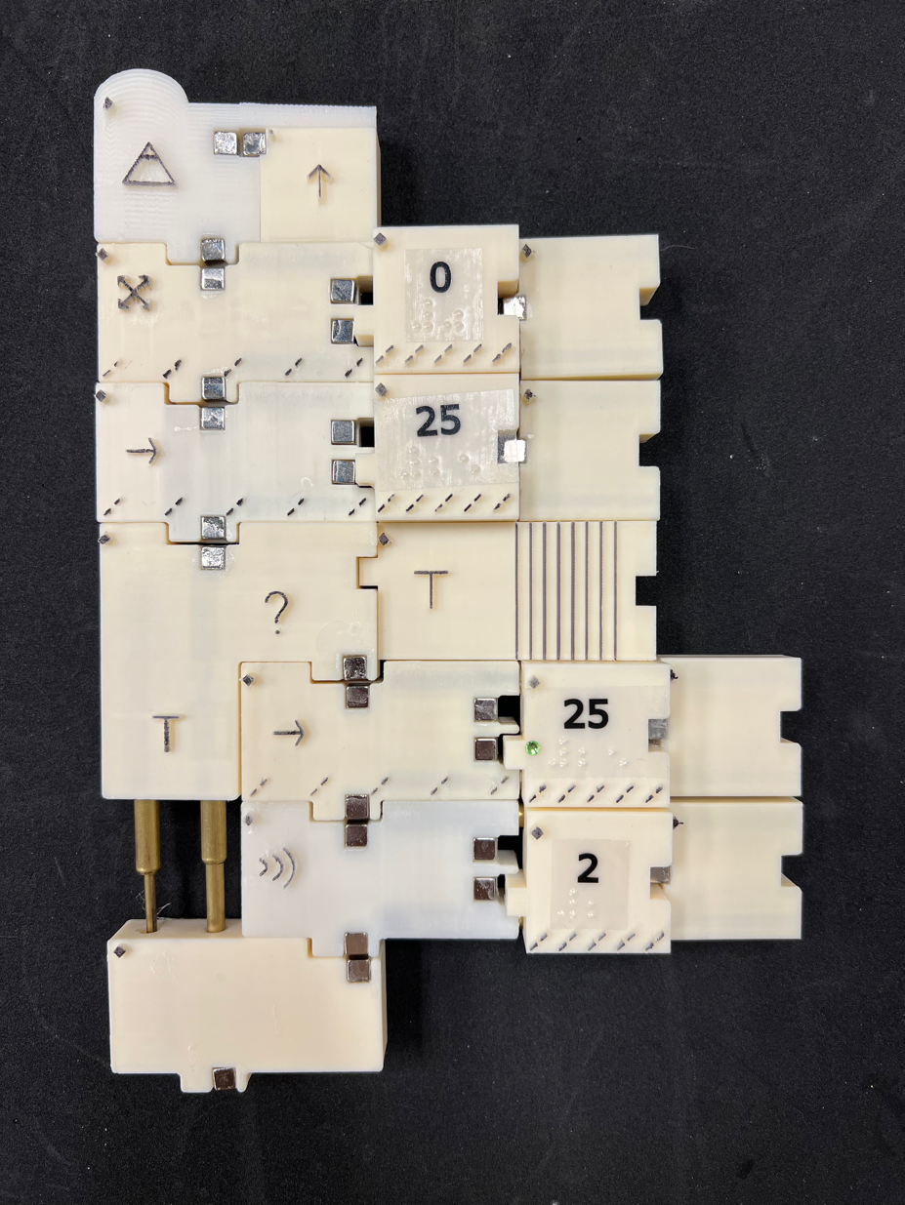
Stage I: Completed Work
Used an evidence based design process with 2 prototype iterations per system component
Developed accessible course material and offered a 2-Day camp to middle and high school BVI students
Current instruction set:
Most blocks from the Motion category
Some blocks from the Control, Event, Operators and Sensing categories

Slide 4
Overview of System
Blocks Palette
Tangible Stage
Worksurface

Slide 5
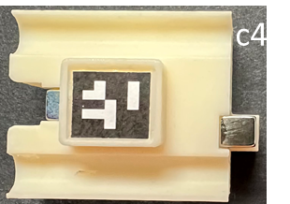
Worksurface

Slide 6
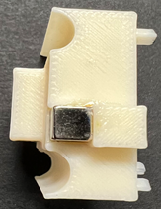
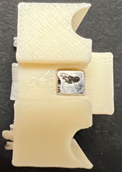
Code Blocks
All blocks have an orientation marker in the upper left corner of the top face
Symbol or large print/Braille in the middle to represent the block command
Texture at the bottom to indicate the category of the block command
Black on white contrast for low vision
This block also has a tab on the left and a notch on the right

Slide 7
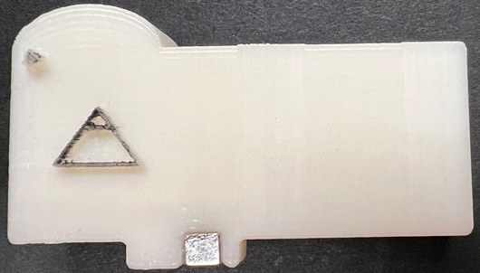
Code Blocks
Tab-notch pairs embed syntax
Magnets added to provide more haptic and audio feedback when blocks correctly join together
Start event (on Enter key)
Block assembly for the glide command

Slide 8
Code Blocks
Command blocks either except numeric or Boolean values or both as parameters/expressions: red = Boolean, green = numeric
Block assembly for the glide command, the 3 parameters can accept Boolean or numeric values
Block assembly for the OR operator, the 2 parameters can only be Boolean values

Slide 9
Code Blocks
The parameter slots are formed with telescoping tubing so that they can fit a single variable or expand to include a nested expression.
The variable (or nested expression) rests on the telescoping tubing.
Block assembly for the greater than operator with a variable X block and a number 30 block

Slide 10
Code Blocks
Nesting expressions adds an additional level in terms of height
Operators, parameters of regular commands and expressions can be nested
An OR operator with a nested Greater Than operator.

Slide 11
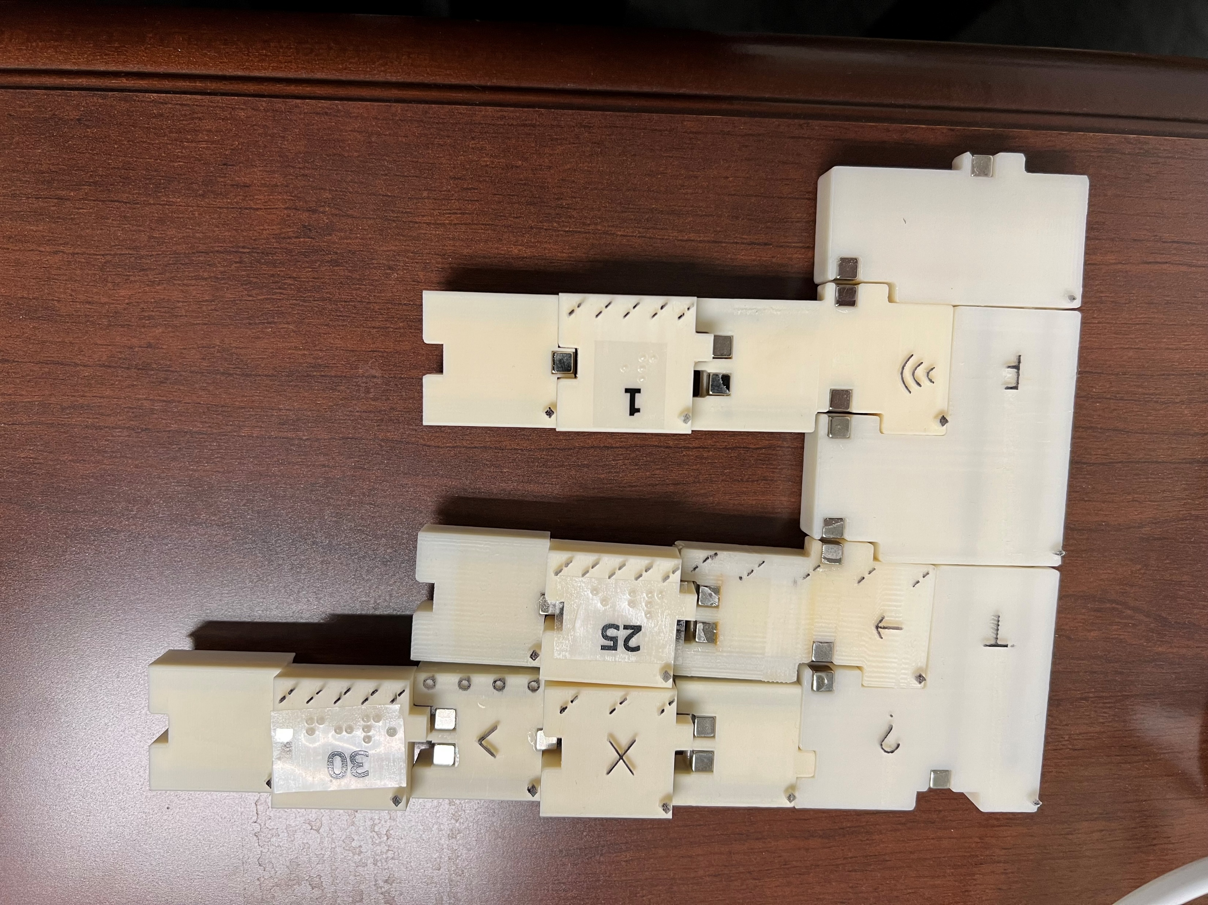
Code Blocks
Nesting can happen in the vertical direction for control commands
If x > 30
Move 25 steps
Else
Beep 1 sec
If-else expression

Slide 12
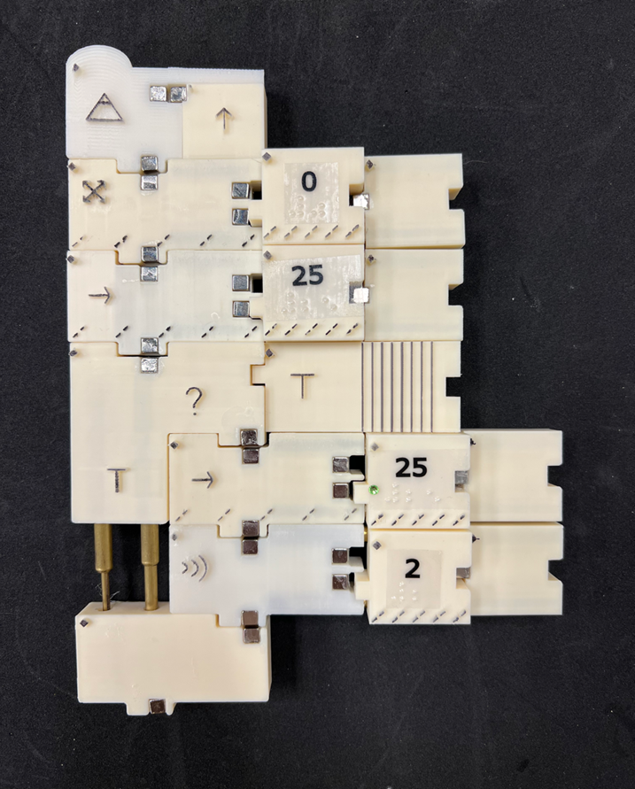
Code Blocks
Example code:
Start on up arrow
Point at 0 degrees
Move 25 steps
If (texture == rough)
Move -25 steps
Beep 2 seconds
End if

Slide 13
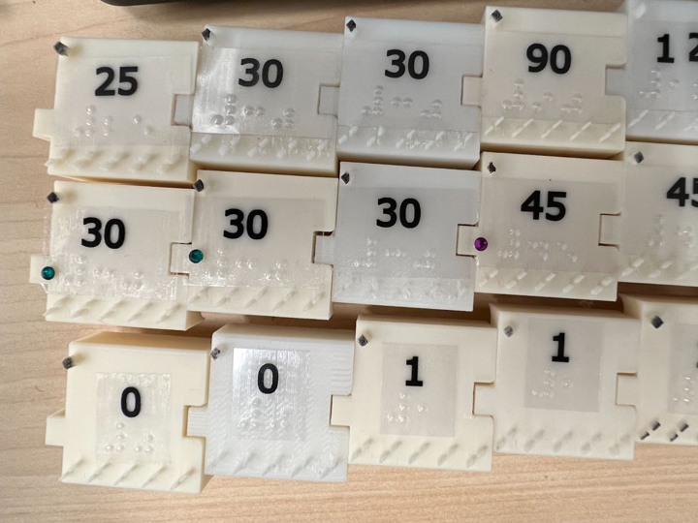
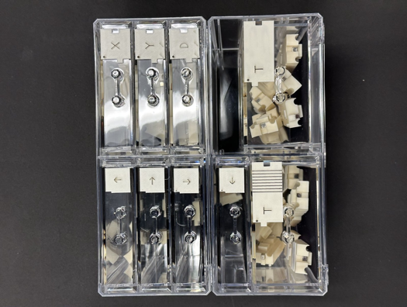
Command Palette
Numbers
Available Commands
Available Variables

Slide 14
Code Execution Stage
Mobile robot
Numeric keypad
Background

Slide 15
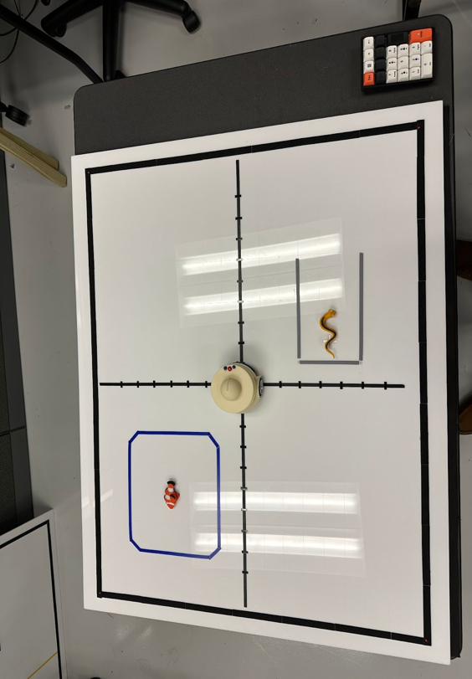
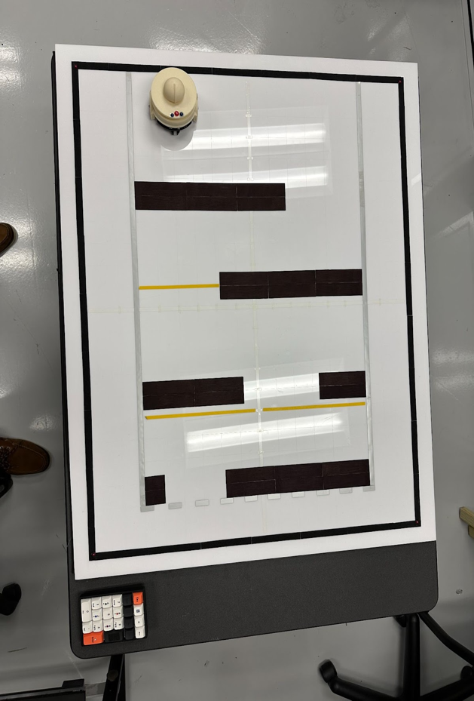
Code Execution Stage
One can add to a standard background to make story or game scenarios

Slide 16
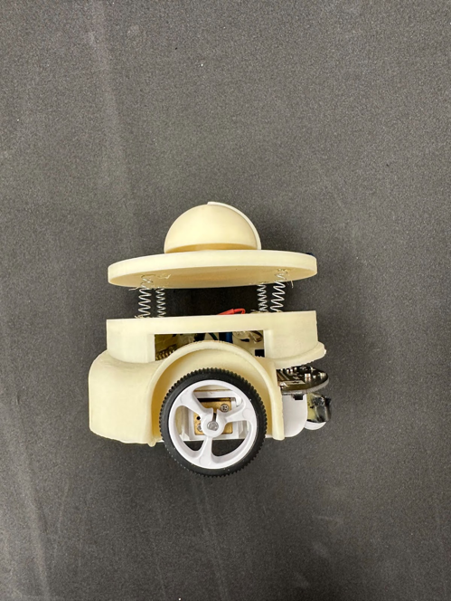
Mobile Robot Sprite
Top View
Side View

Slide 17
Future Work
Stage II
System: revisions based on student feedback, additional block commands including those in the sound category
Website: student sharing of projects with those on actual Scratch website, teaching resources, career mentoring and educational guidance
Camps for BVI students: Hold 1 week camps at multiple sites, focusing on Science Centers
Assessment
Stage III
System: revisions based on student/teacher feedback, modifications for “large” scale manufacturing
Website: educational resources for school term courses
Assessment

